Slide 1

TEAM MEMBERS
Indian Institute Of Information Technology , Design and Manufacturing, Kurnool
SYSTEM
EMBEDDED
PRACTICE

Slide 2
TEAM MEMBERS
Indian Institute Of Information Technology , Design and Manufacturing, Kurnool
SYSTEM
EMBEDDED
PRACTICE
TEAM MEMBERS
Hitesh Bhoyar (122EC0021)
Prateesh Kumar Nayyar (122EC0054)
Gaurav Kumar (122EC0030)
Vishal (122EC0022)
Nafis Rashid (122EC0049)
Subhash Chandra Teku (122EC0027)

Slide 3
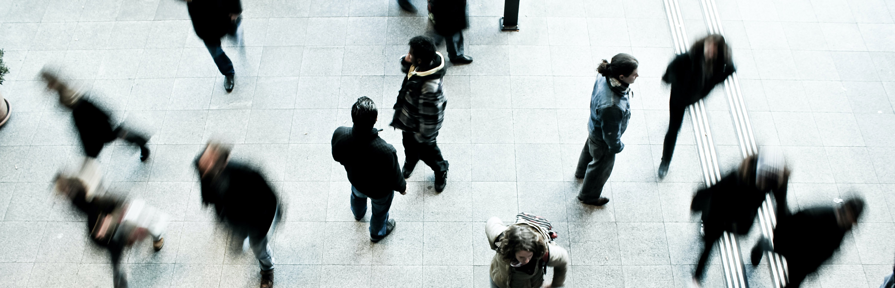
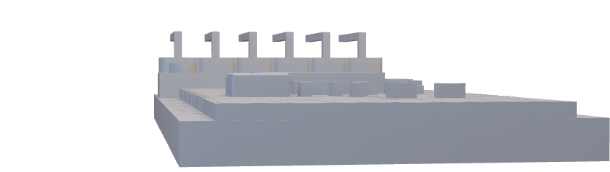
OBJECTIVES
To Reduce Light pollution by detecting the light intensity
To reduce sound pollution by detecting surrounding of the vehicle.

Slide 4
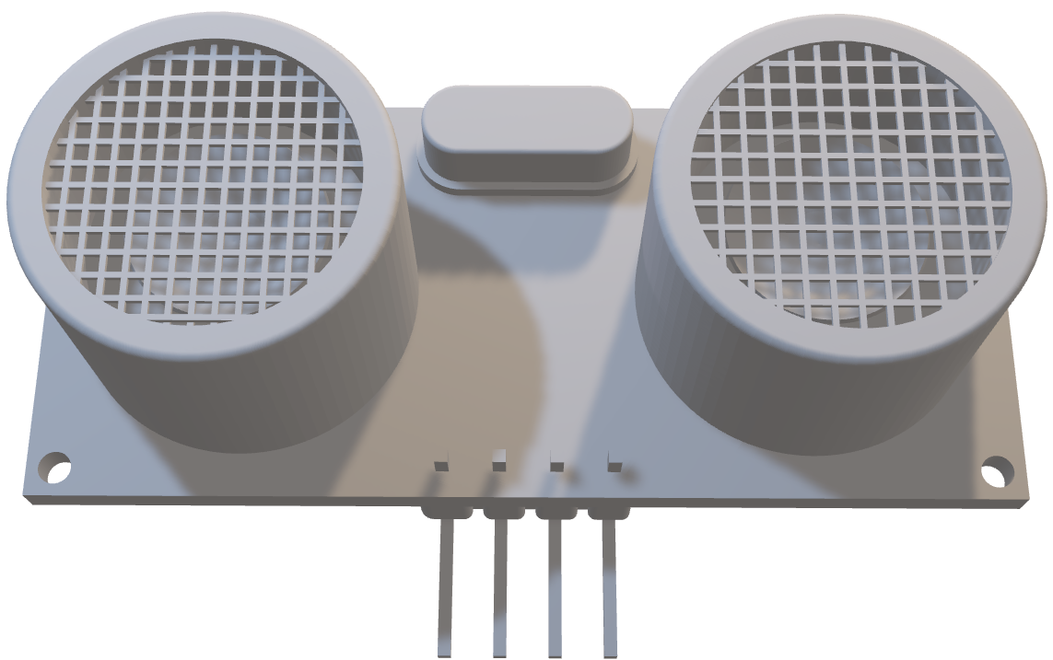
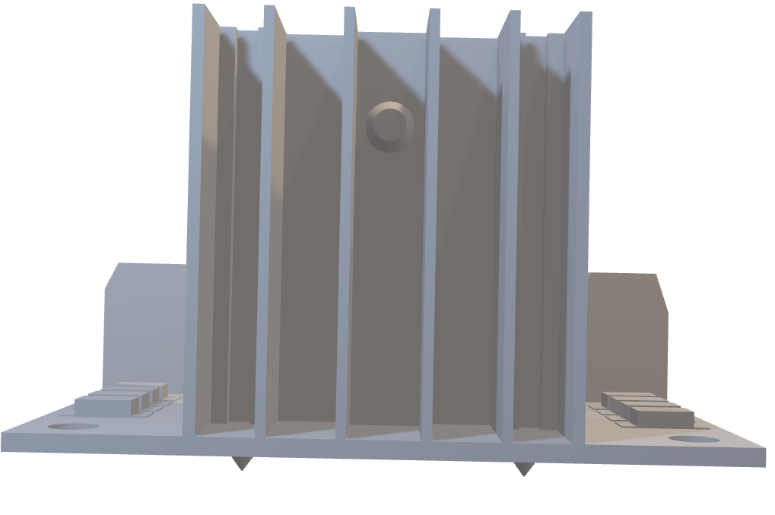
COMPONENTS USED :
HINT: To change this single image.
1- Right Click on top of the image.
2- Choose “Change Picture” 3- Choose option “From a File” 4- Locate your file and open
ULTRASONIC SENSOR

Slide 5
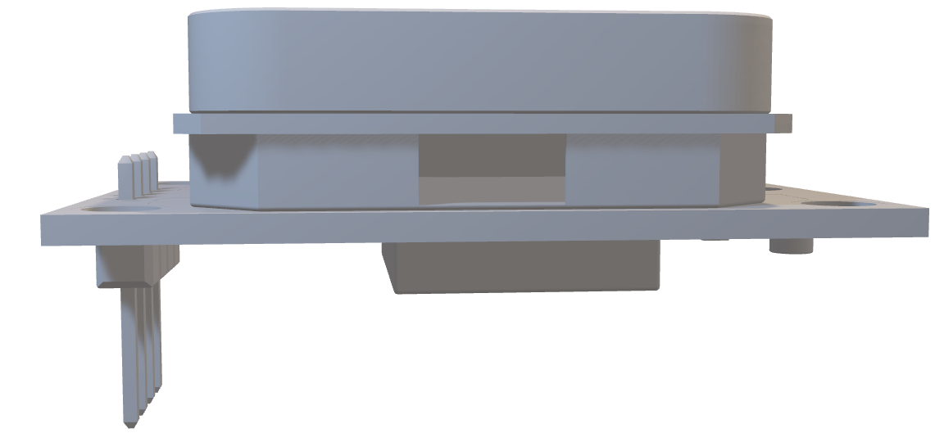
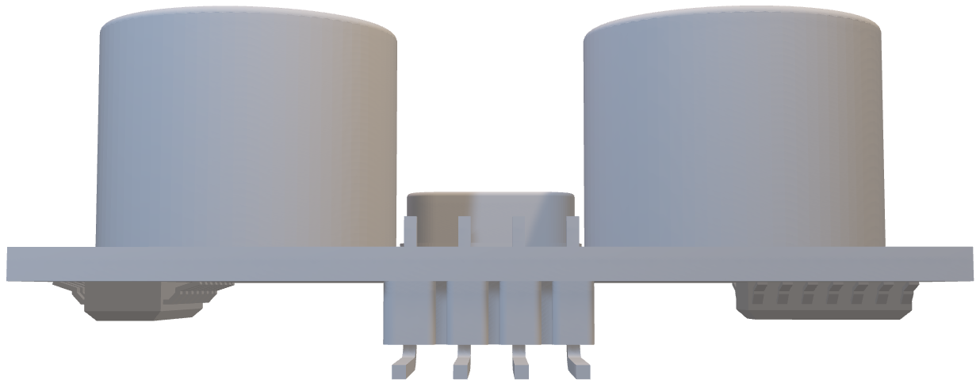
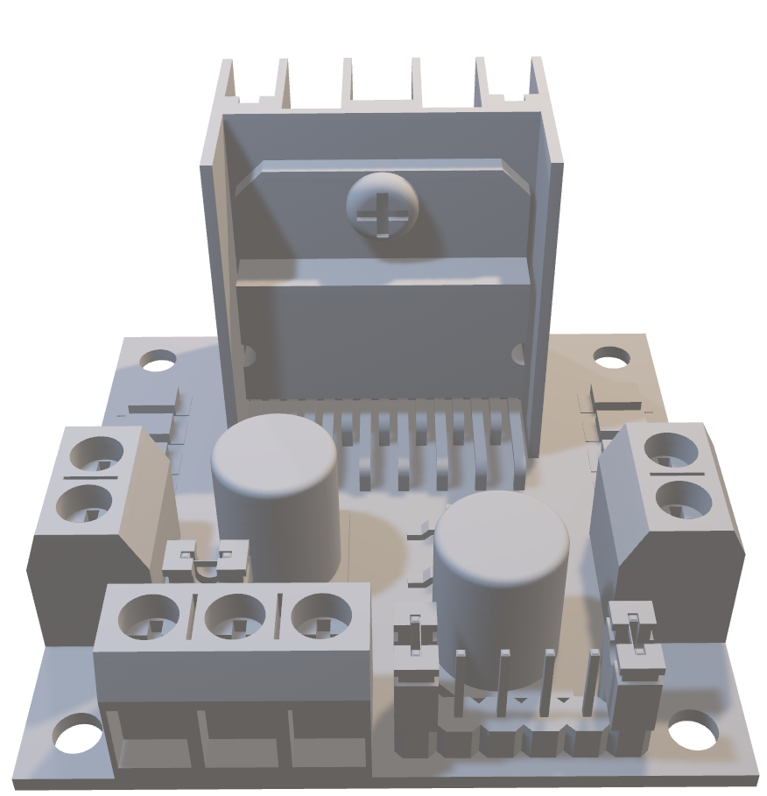
COMPONENTS USED :
HINT: To change this single image.
1- Right Click on top of the image.
2- Choose “Change Picture” 3- Choose option “From a File” 4- Locate your file and open
MOTOR DRIVER

Slide 6
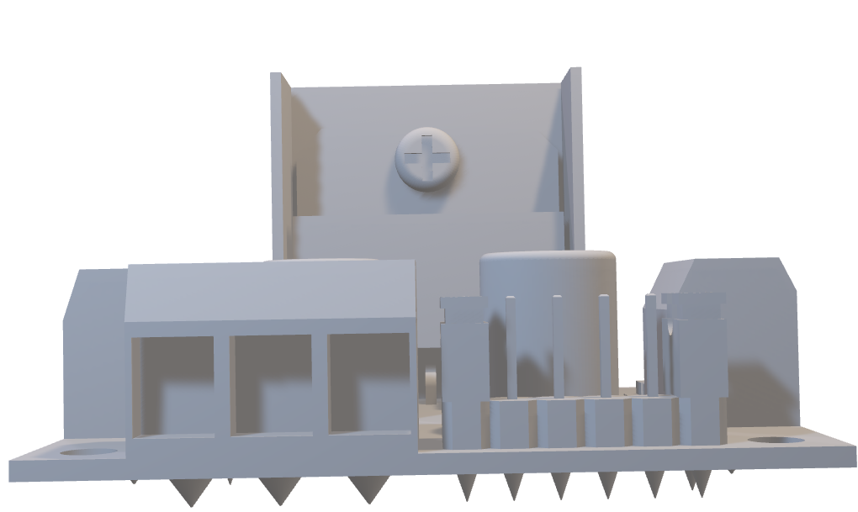
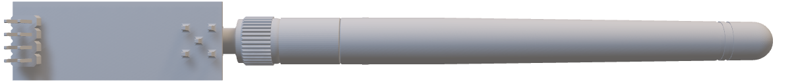
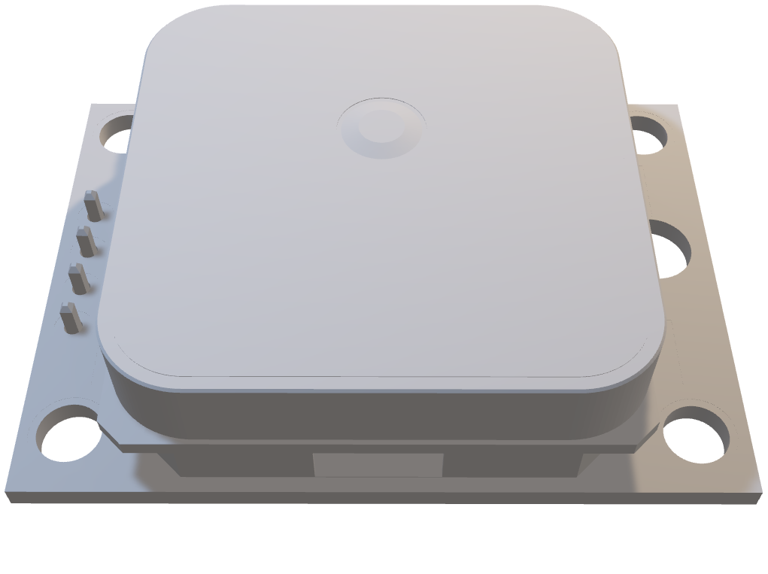
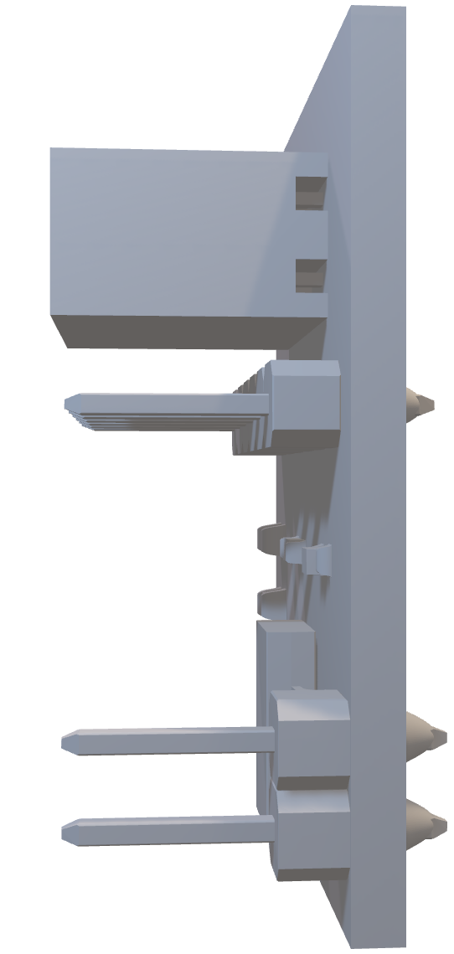
COMPONENTS USED :
HINT: To change this single image.
1- Right Click on top of the image.
2- Choose “Change Picture” 3- Choose option “From a File” 4- Locate your file and open
GPS NEO-6M MODULE

Slide 7
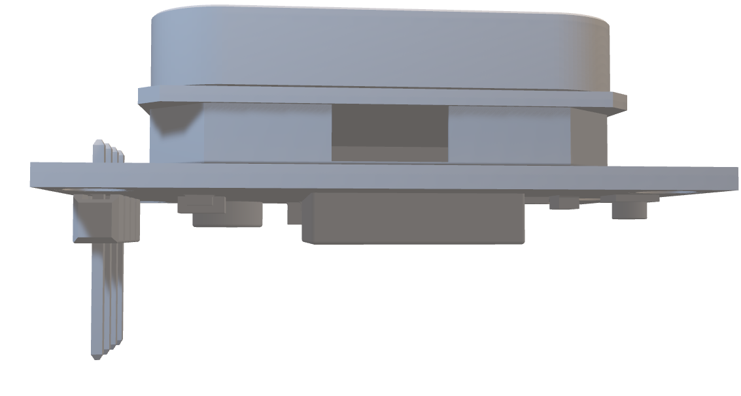
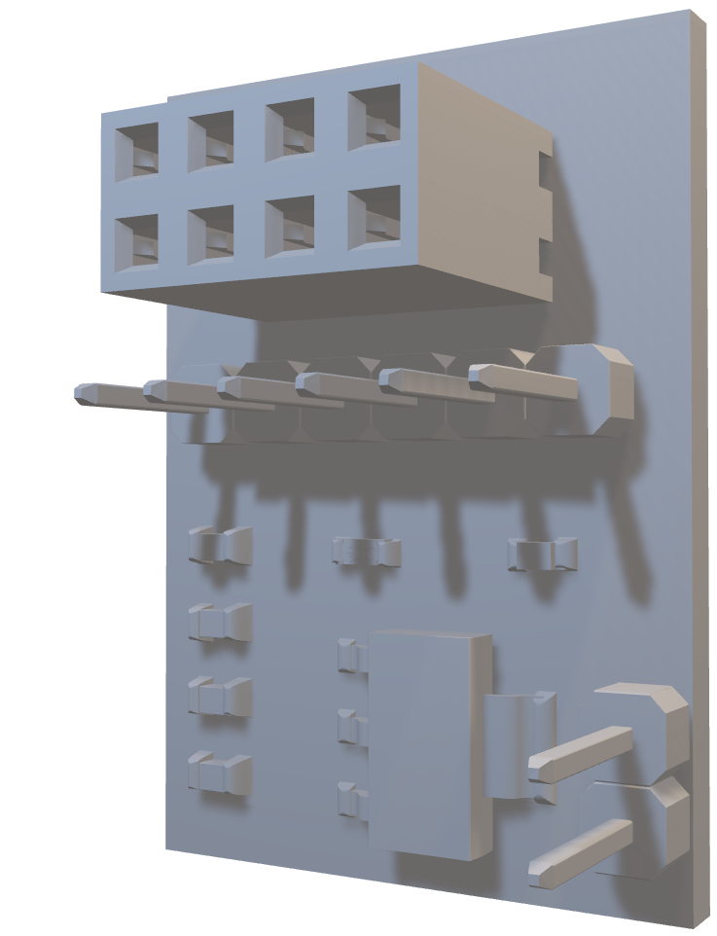
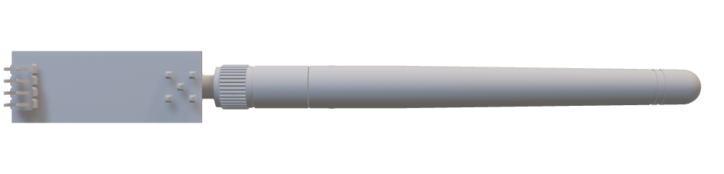
COMPONENTS USED :
HINT: To change this single image.
1- Right Click on top of the image.
2- Choose “Change Picture” 3- Choose option “From a File” 4- Locate your file and open
NRF24L01 TRANCEIVER ANTENNA AND ADAPTOR

Slide 8
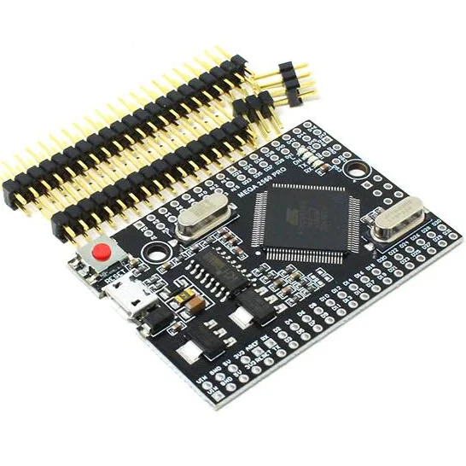
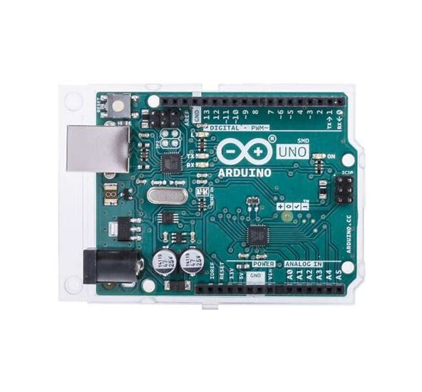
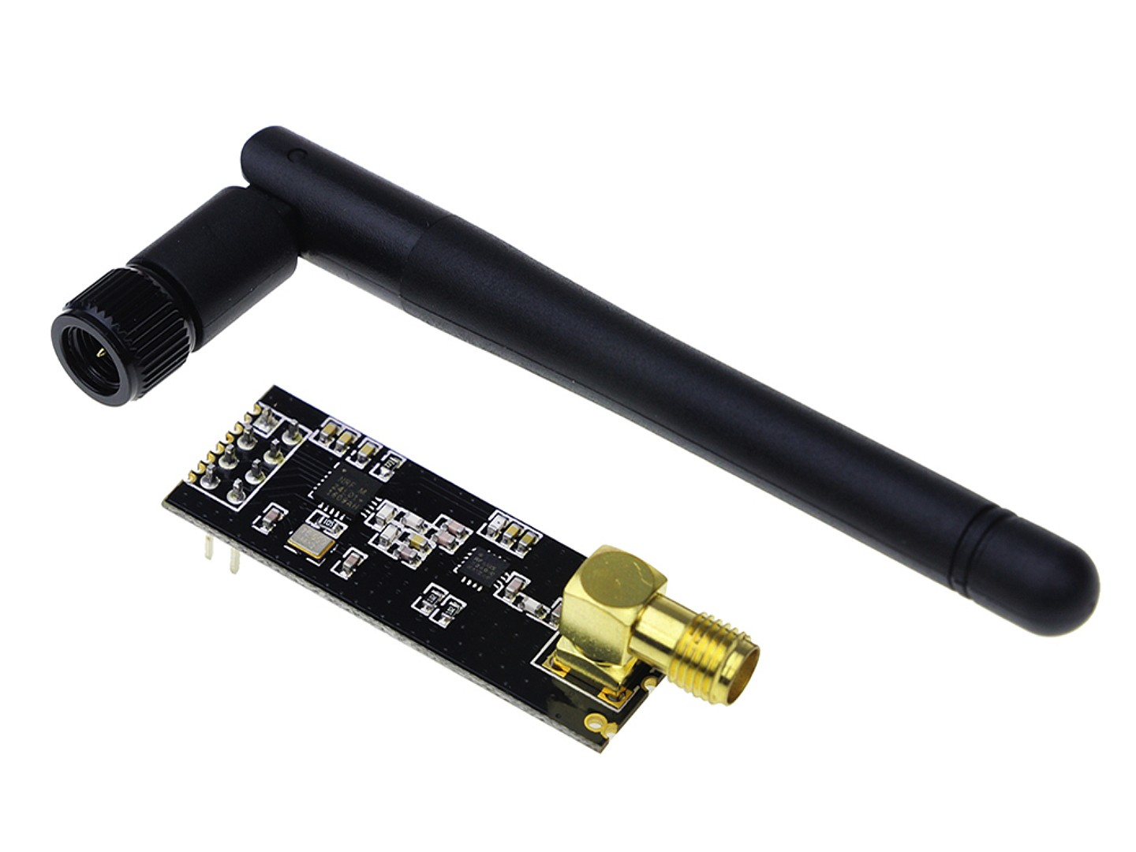
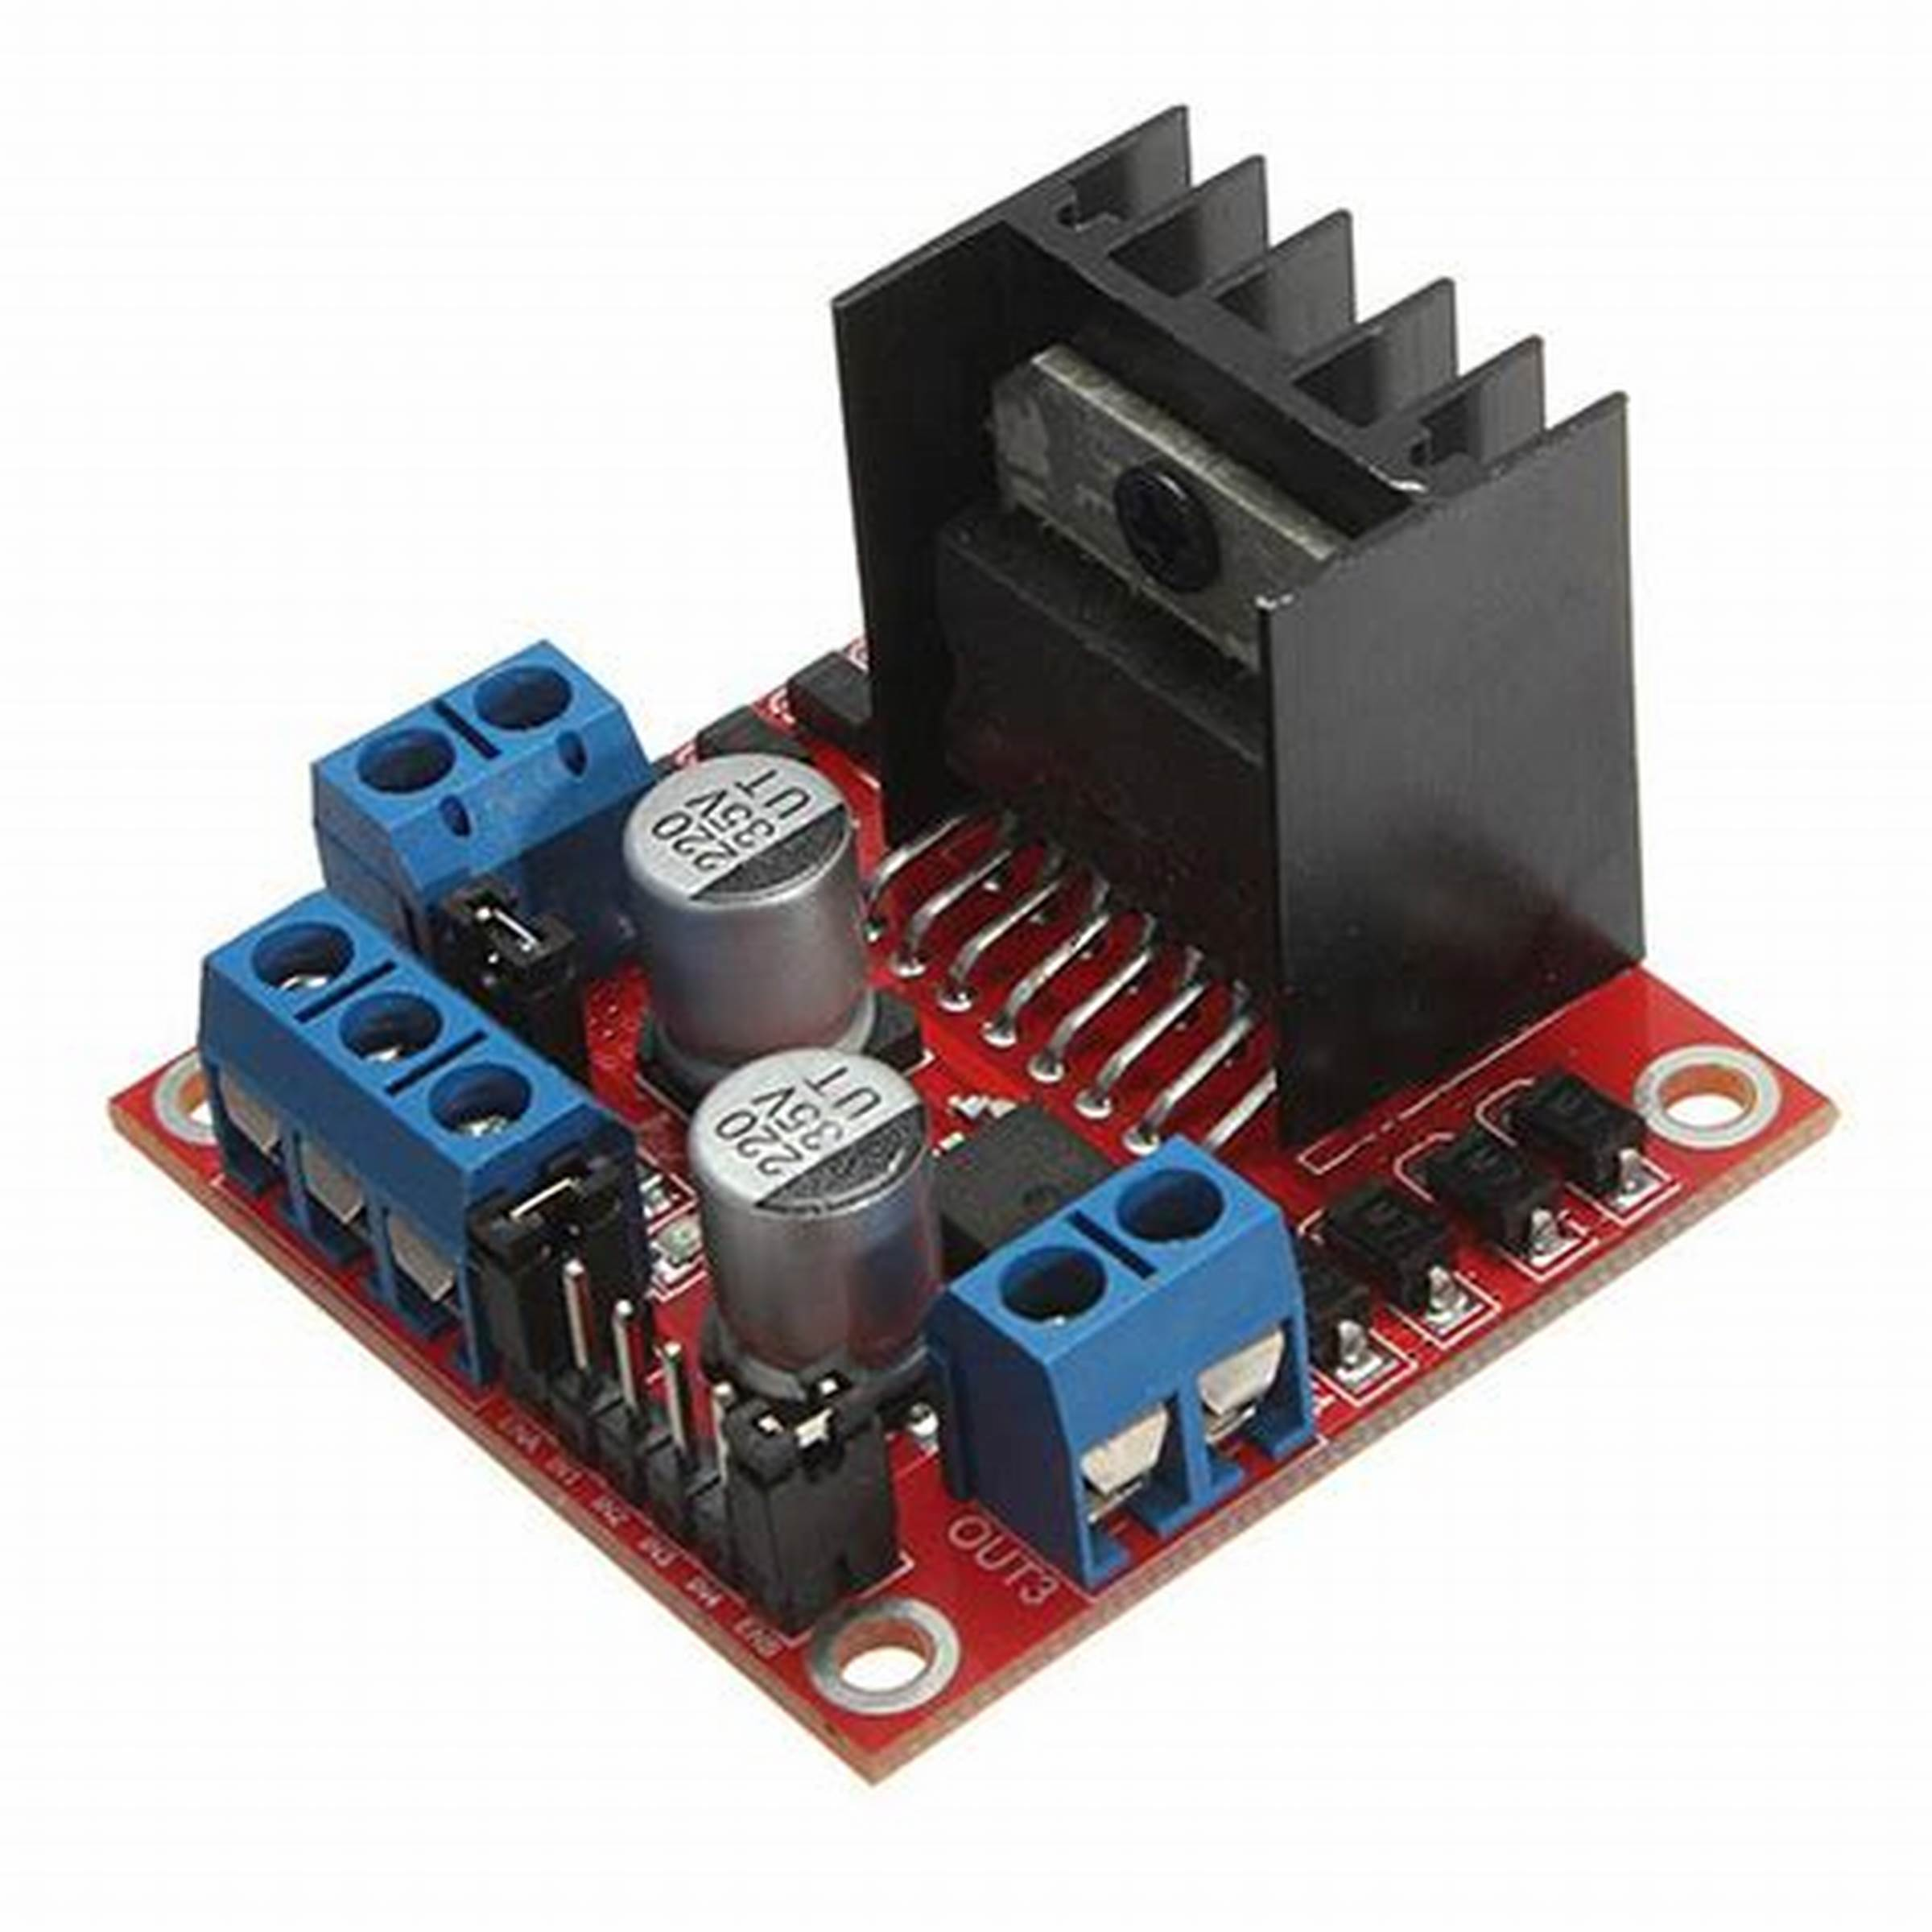
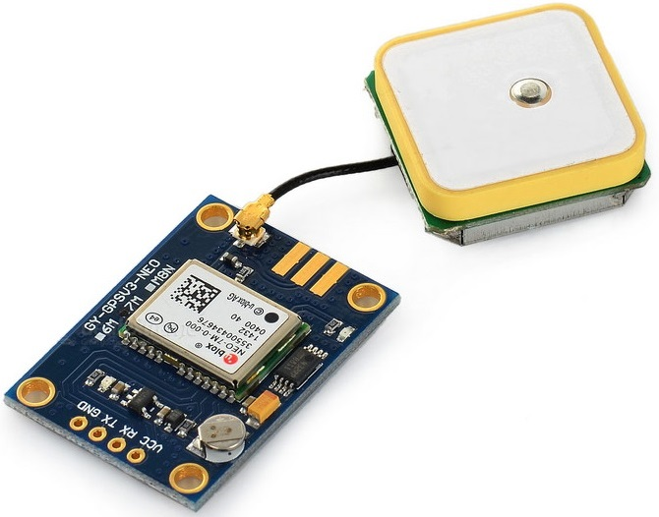
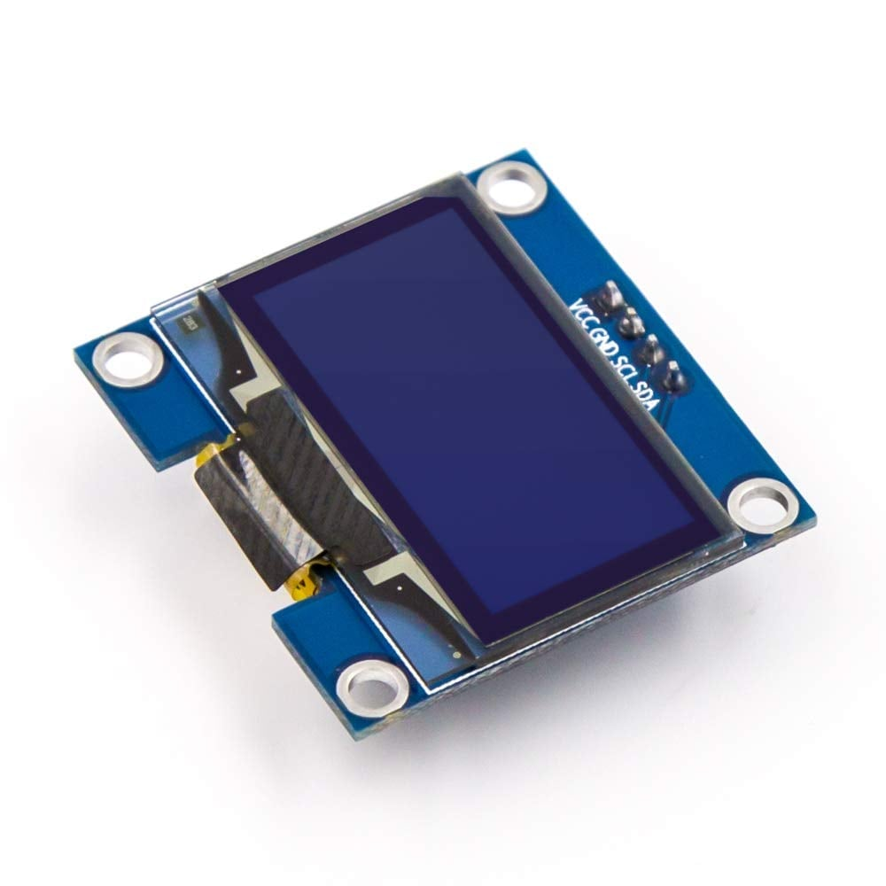
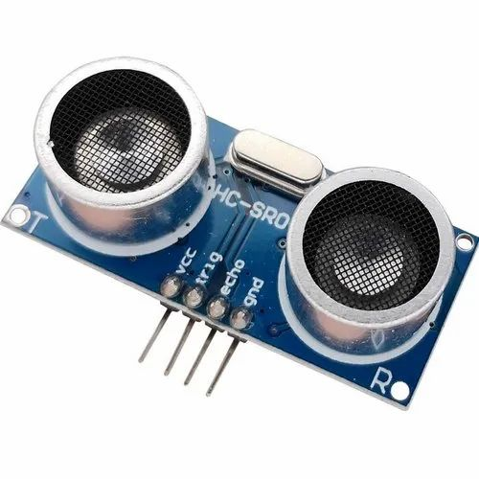
MAJOR ELECTRICAL COMPONENTS USED :
HINT: To change this single image.
1- Right Click on top of the image.
2- Choose “Change Picture” 3- Choose option “From a File” 4- Locate your file and open

Slide 9
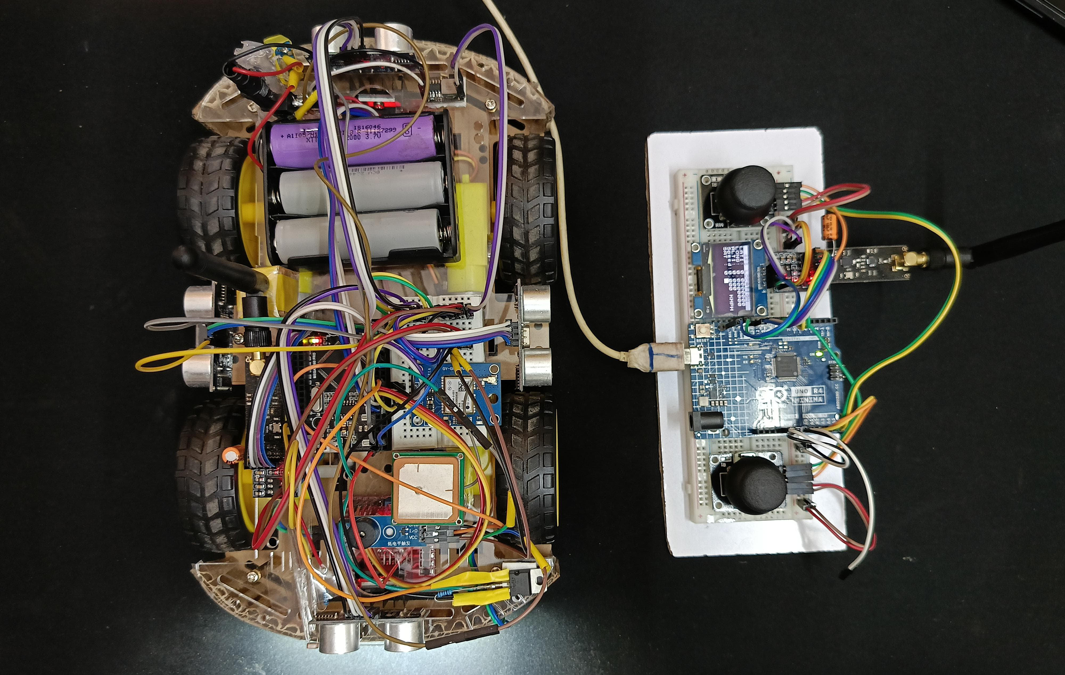
HINT: To change this single image.
1- Right Click on top of the image.
2- Choose “Change Picture” 3- Choose option “From a File” 4- Locate your file and open

Slide 10
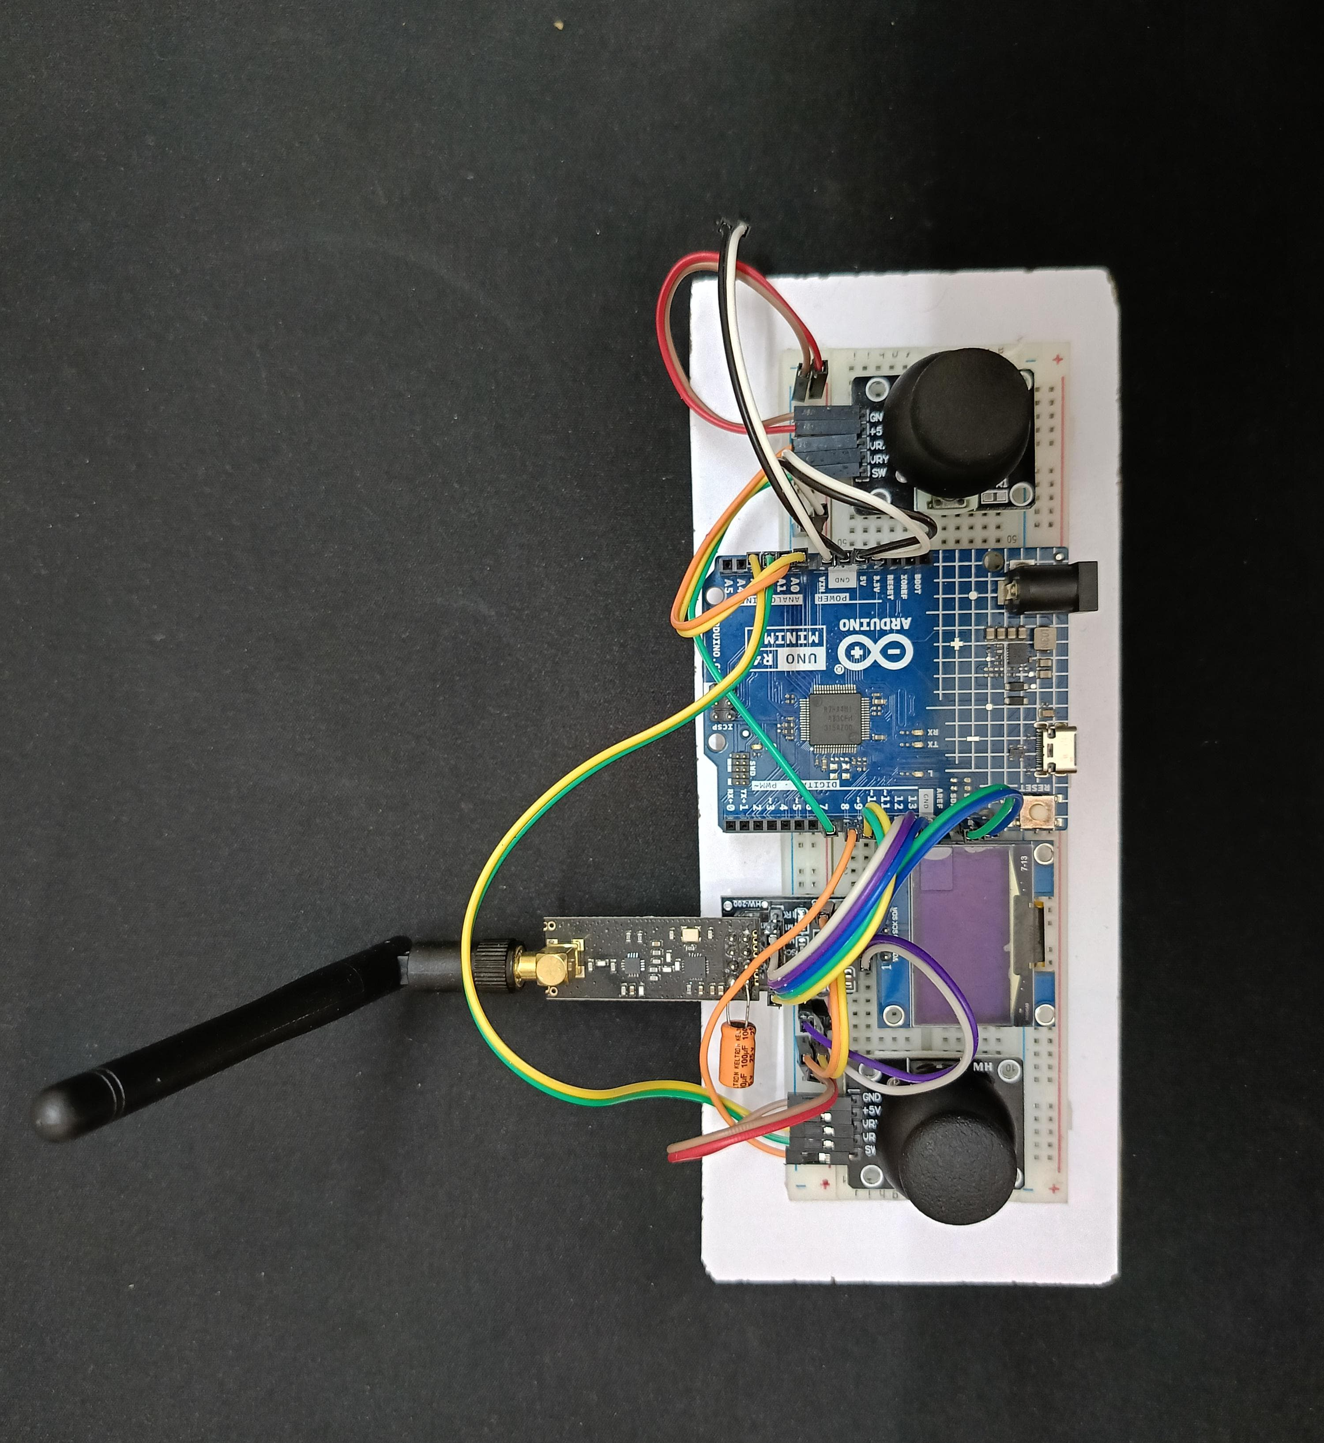
HINT: To change this single image.
1- Right Click on top of the image.
2- Choose “Change Picture” 3- Choose option “From a File” 4- Locate your file and open

Slide 11
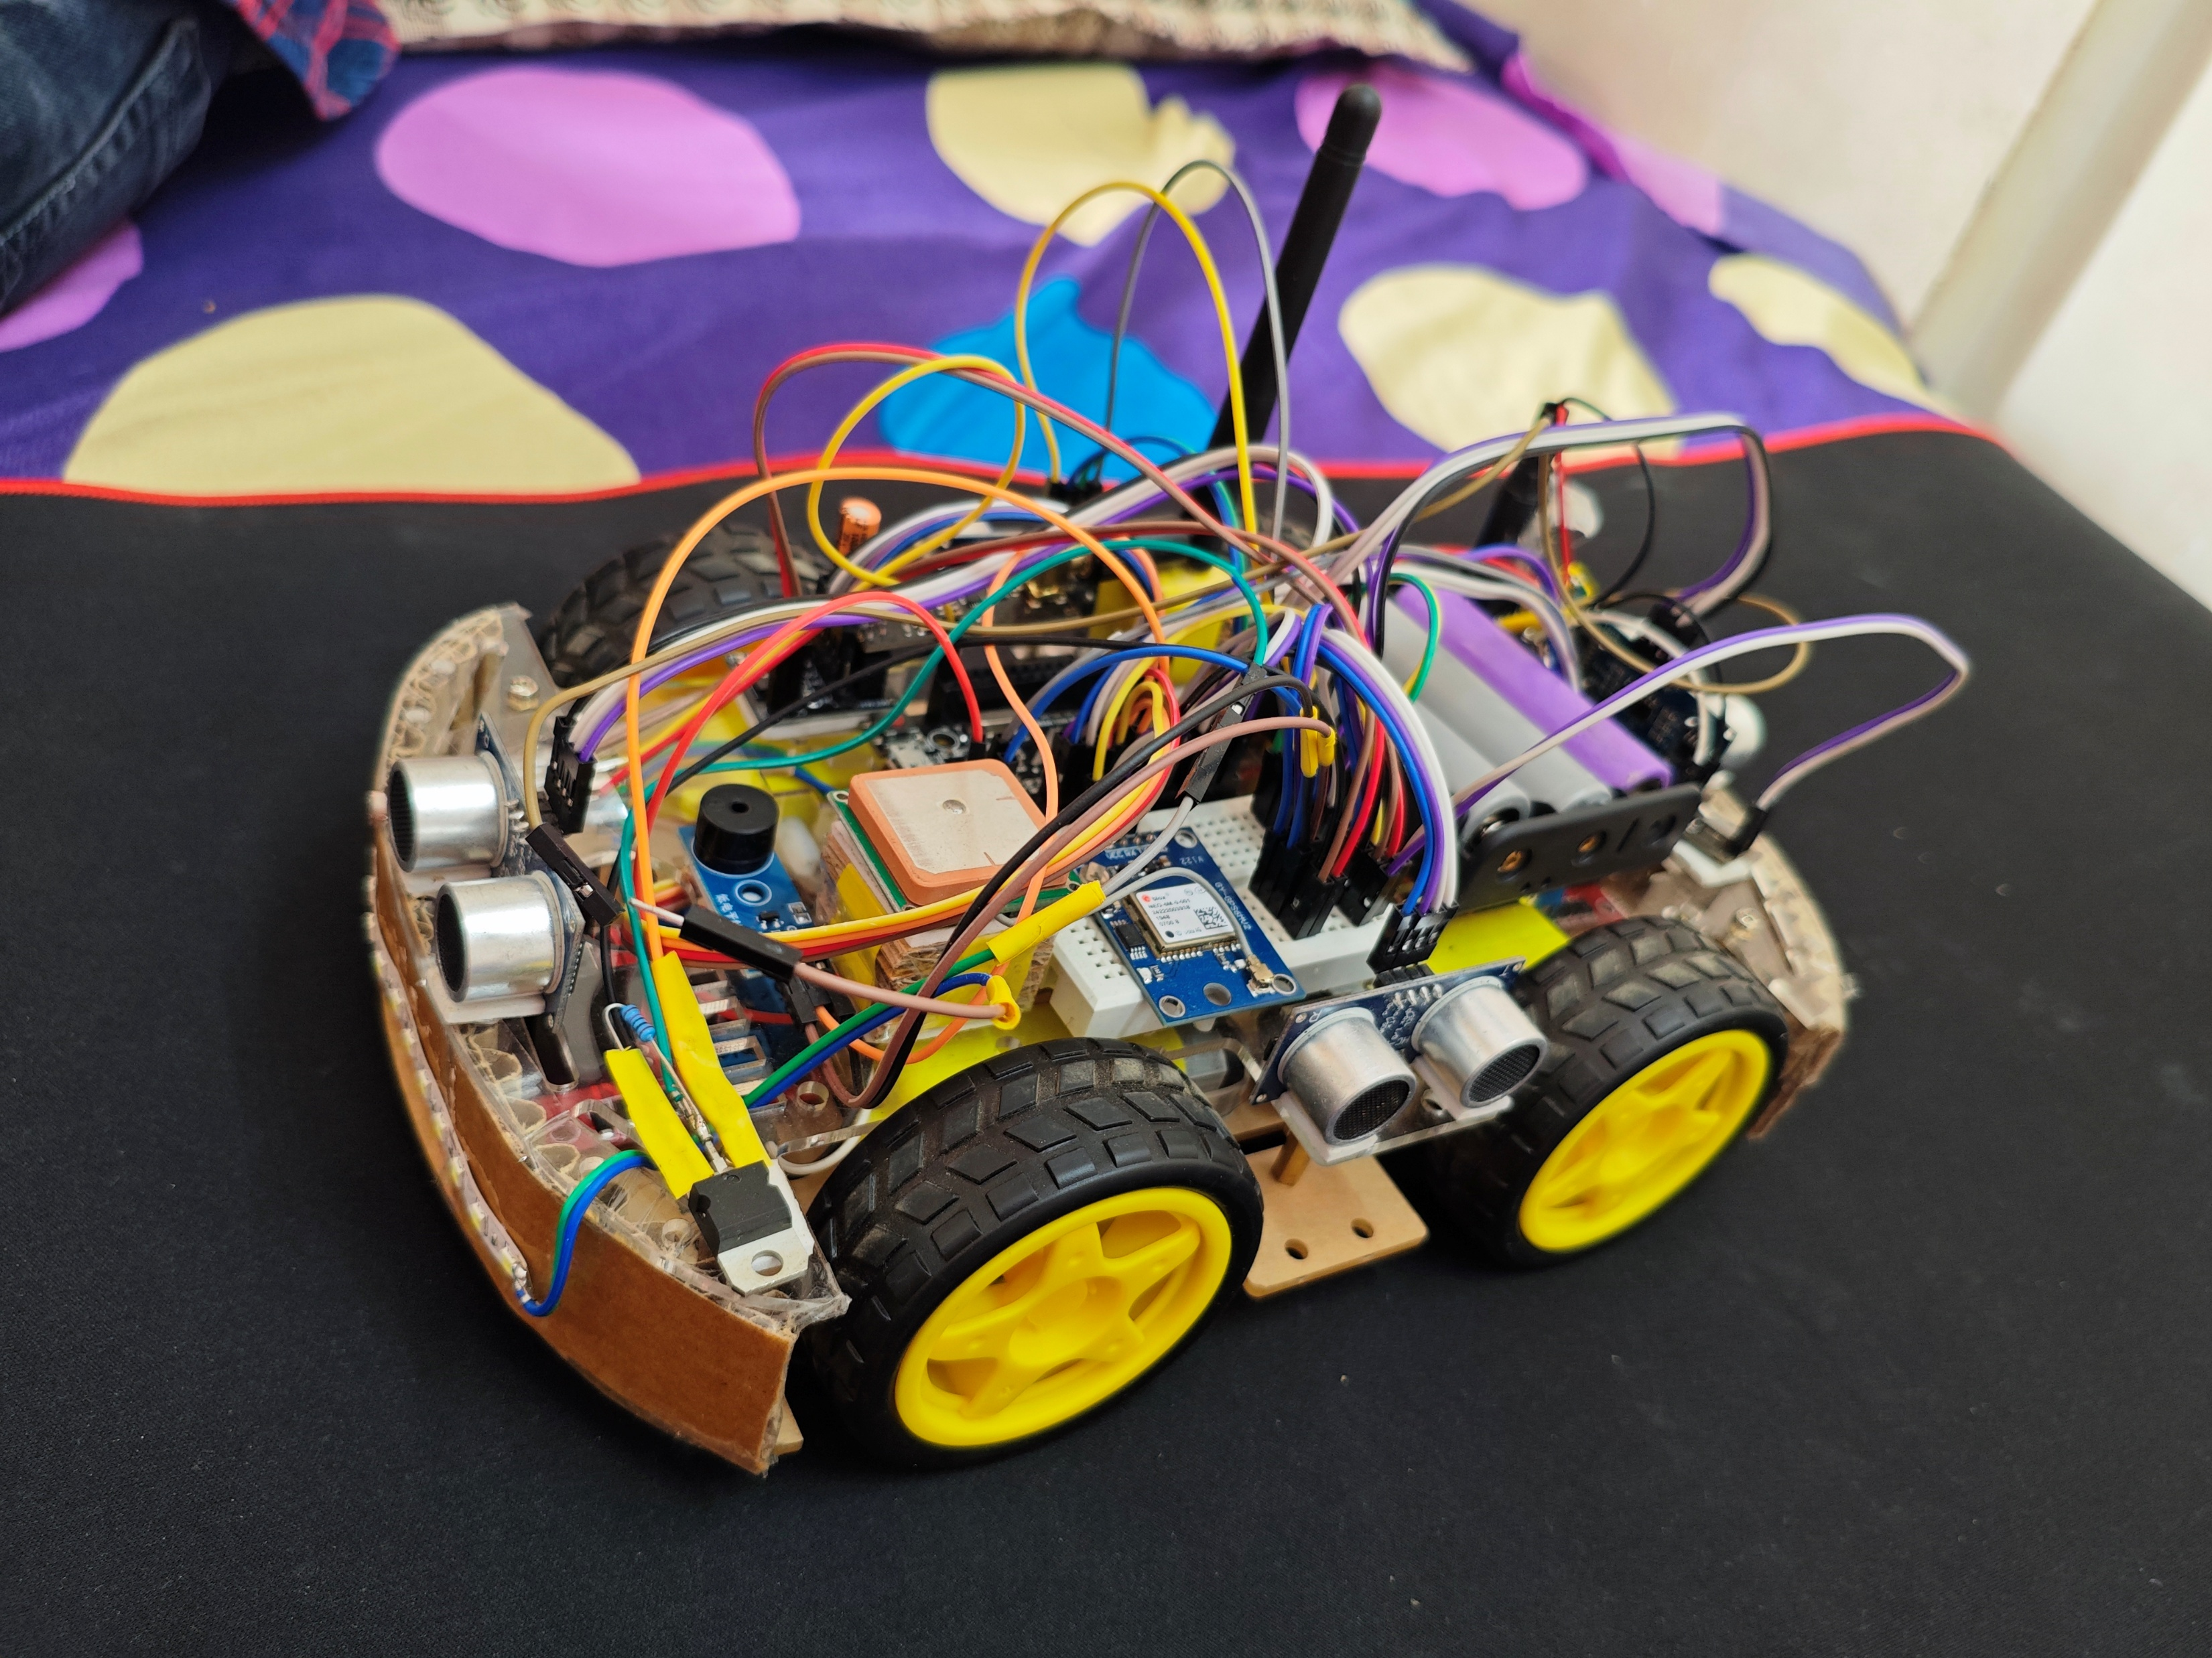
HINT: To change this single image.
1- Right Click on top of the image.
2- Choose “Change Picture” 3- Choose option “From a File” 4- Locate your file and open

Slide 12
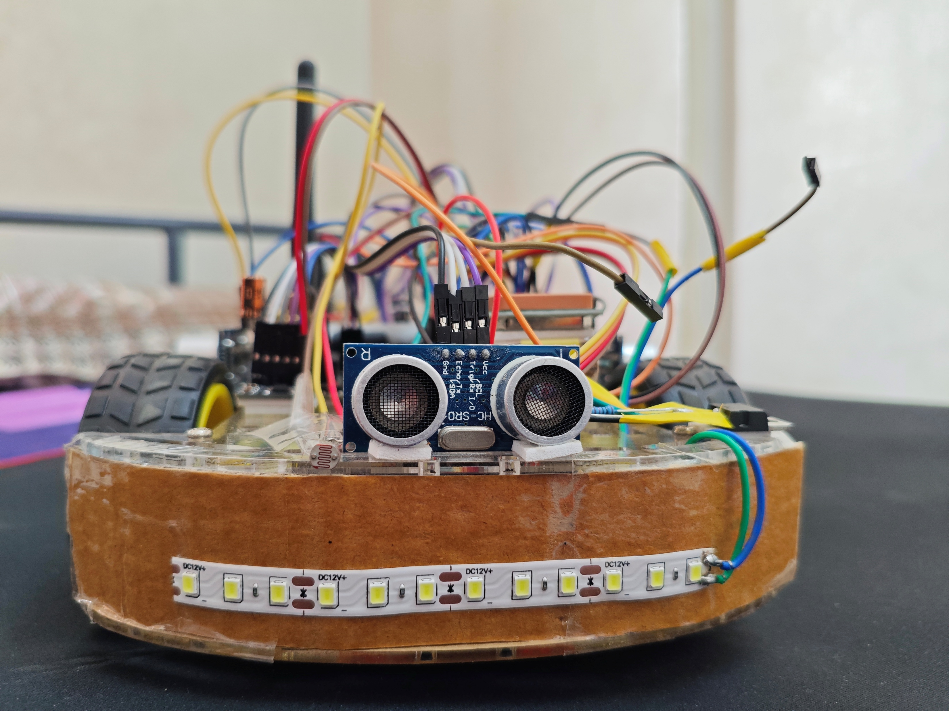

Slide 13
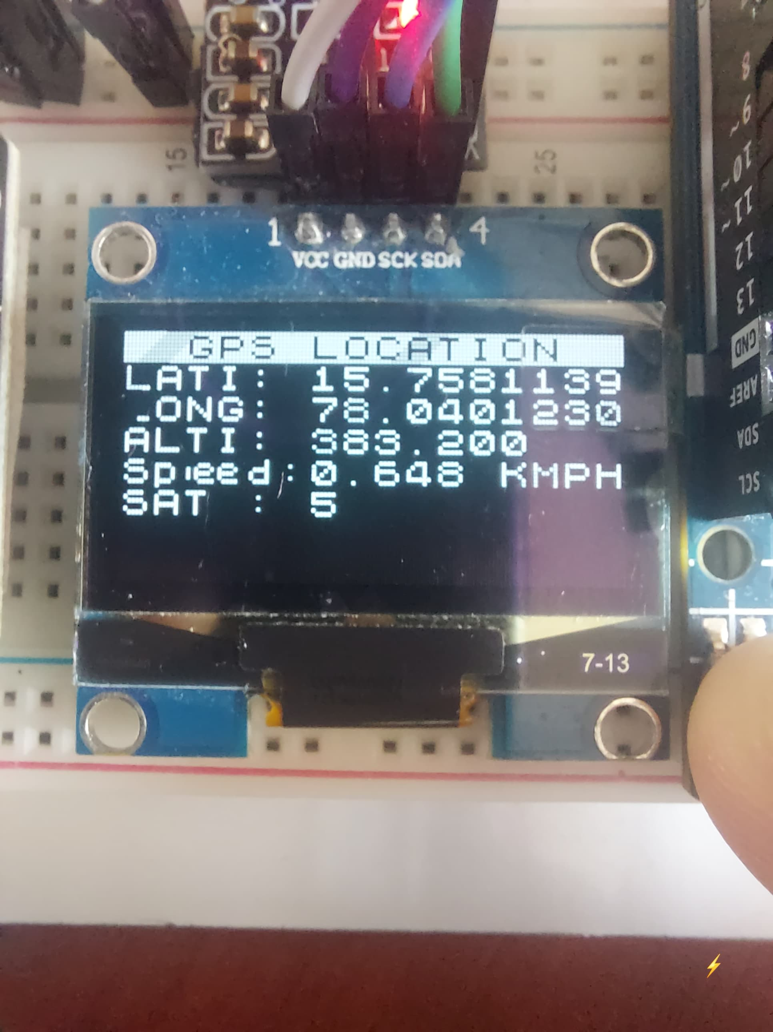
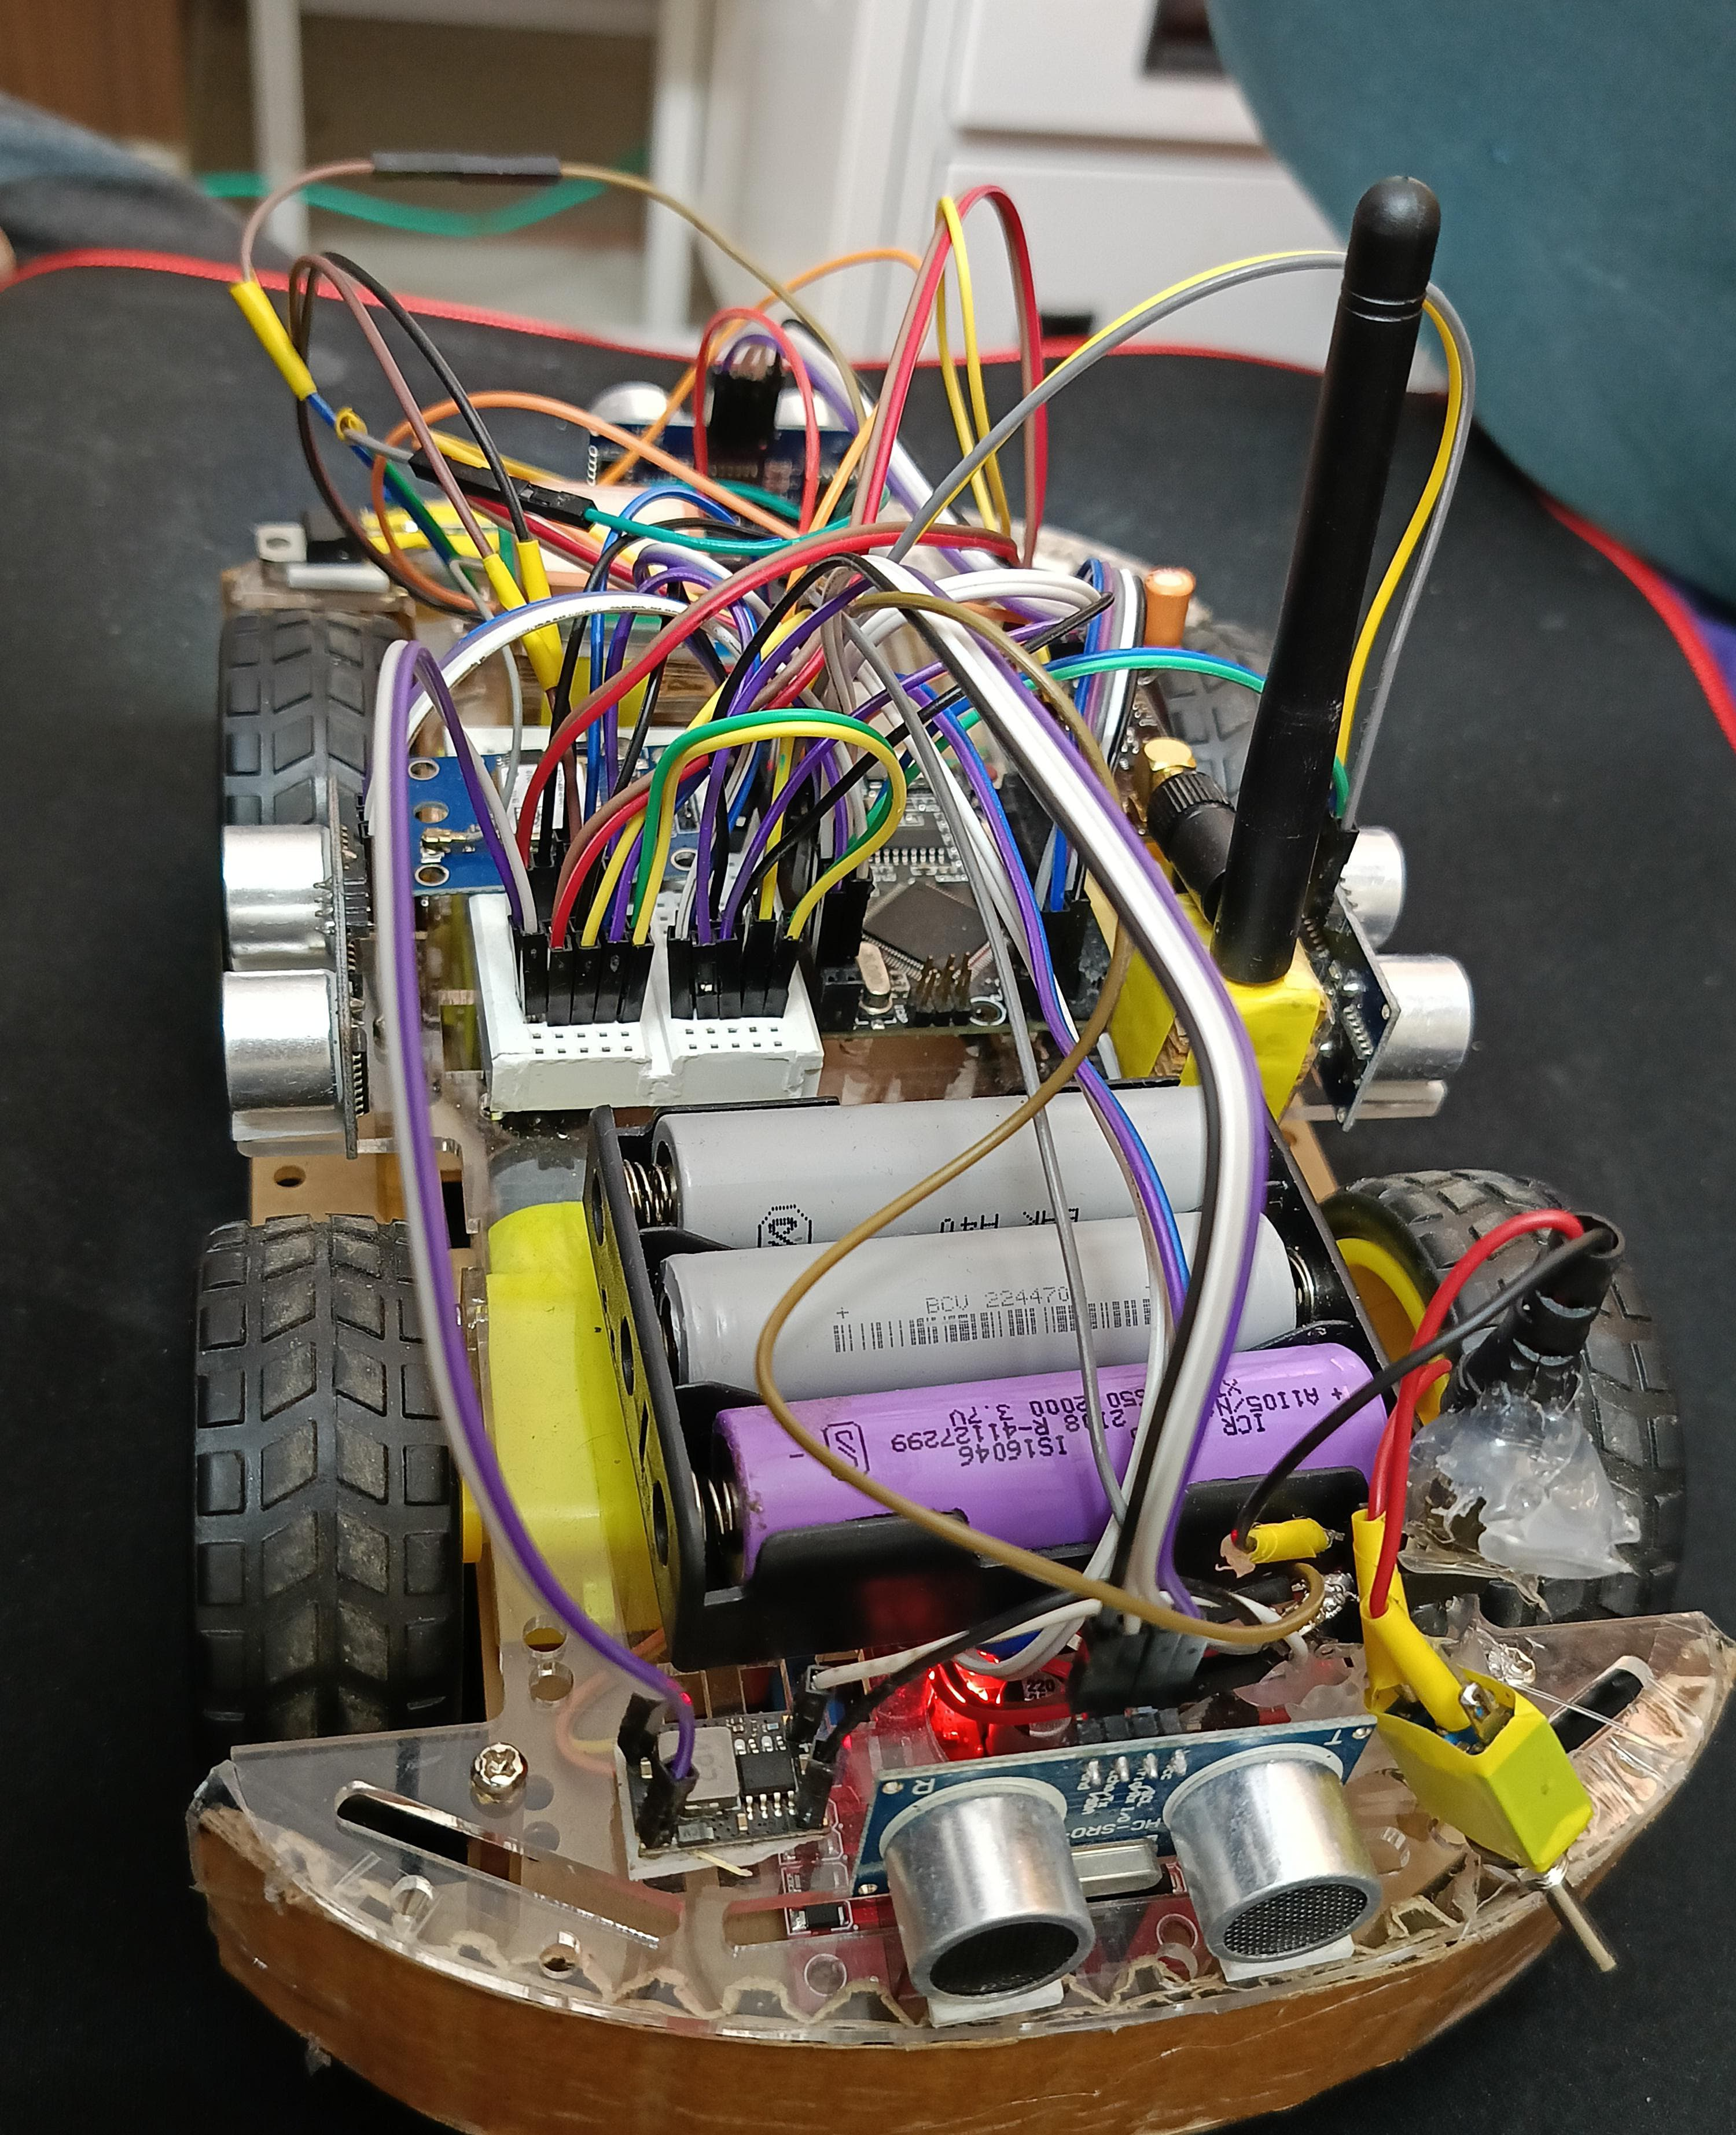
HINT: To change this single image.
1- Right Click on top of the image.
2- Choose “Change Picture” 3- Choose option “From a File” 4- Locate your file and open

Slide 14
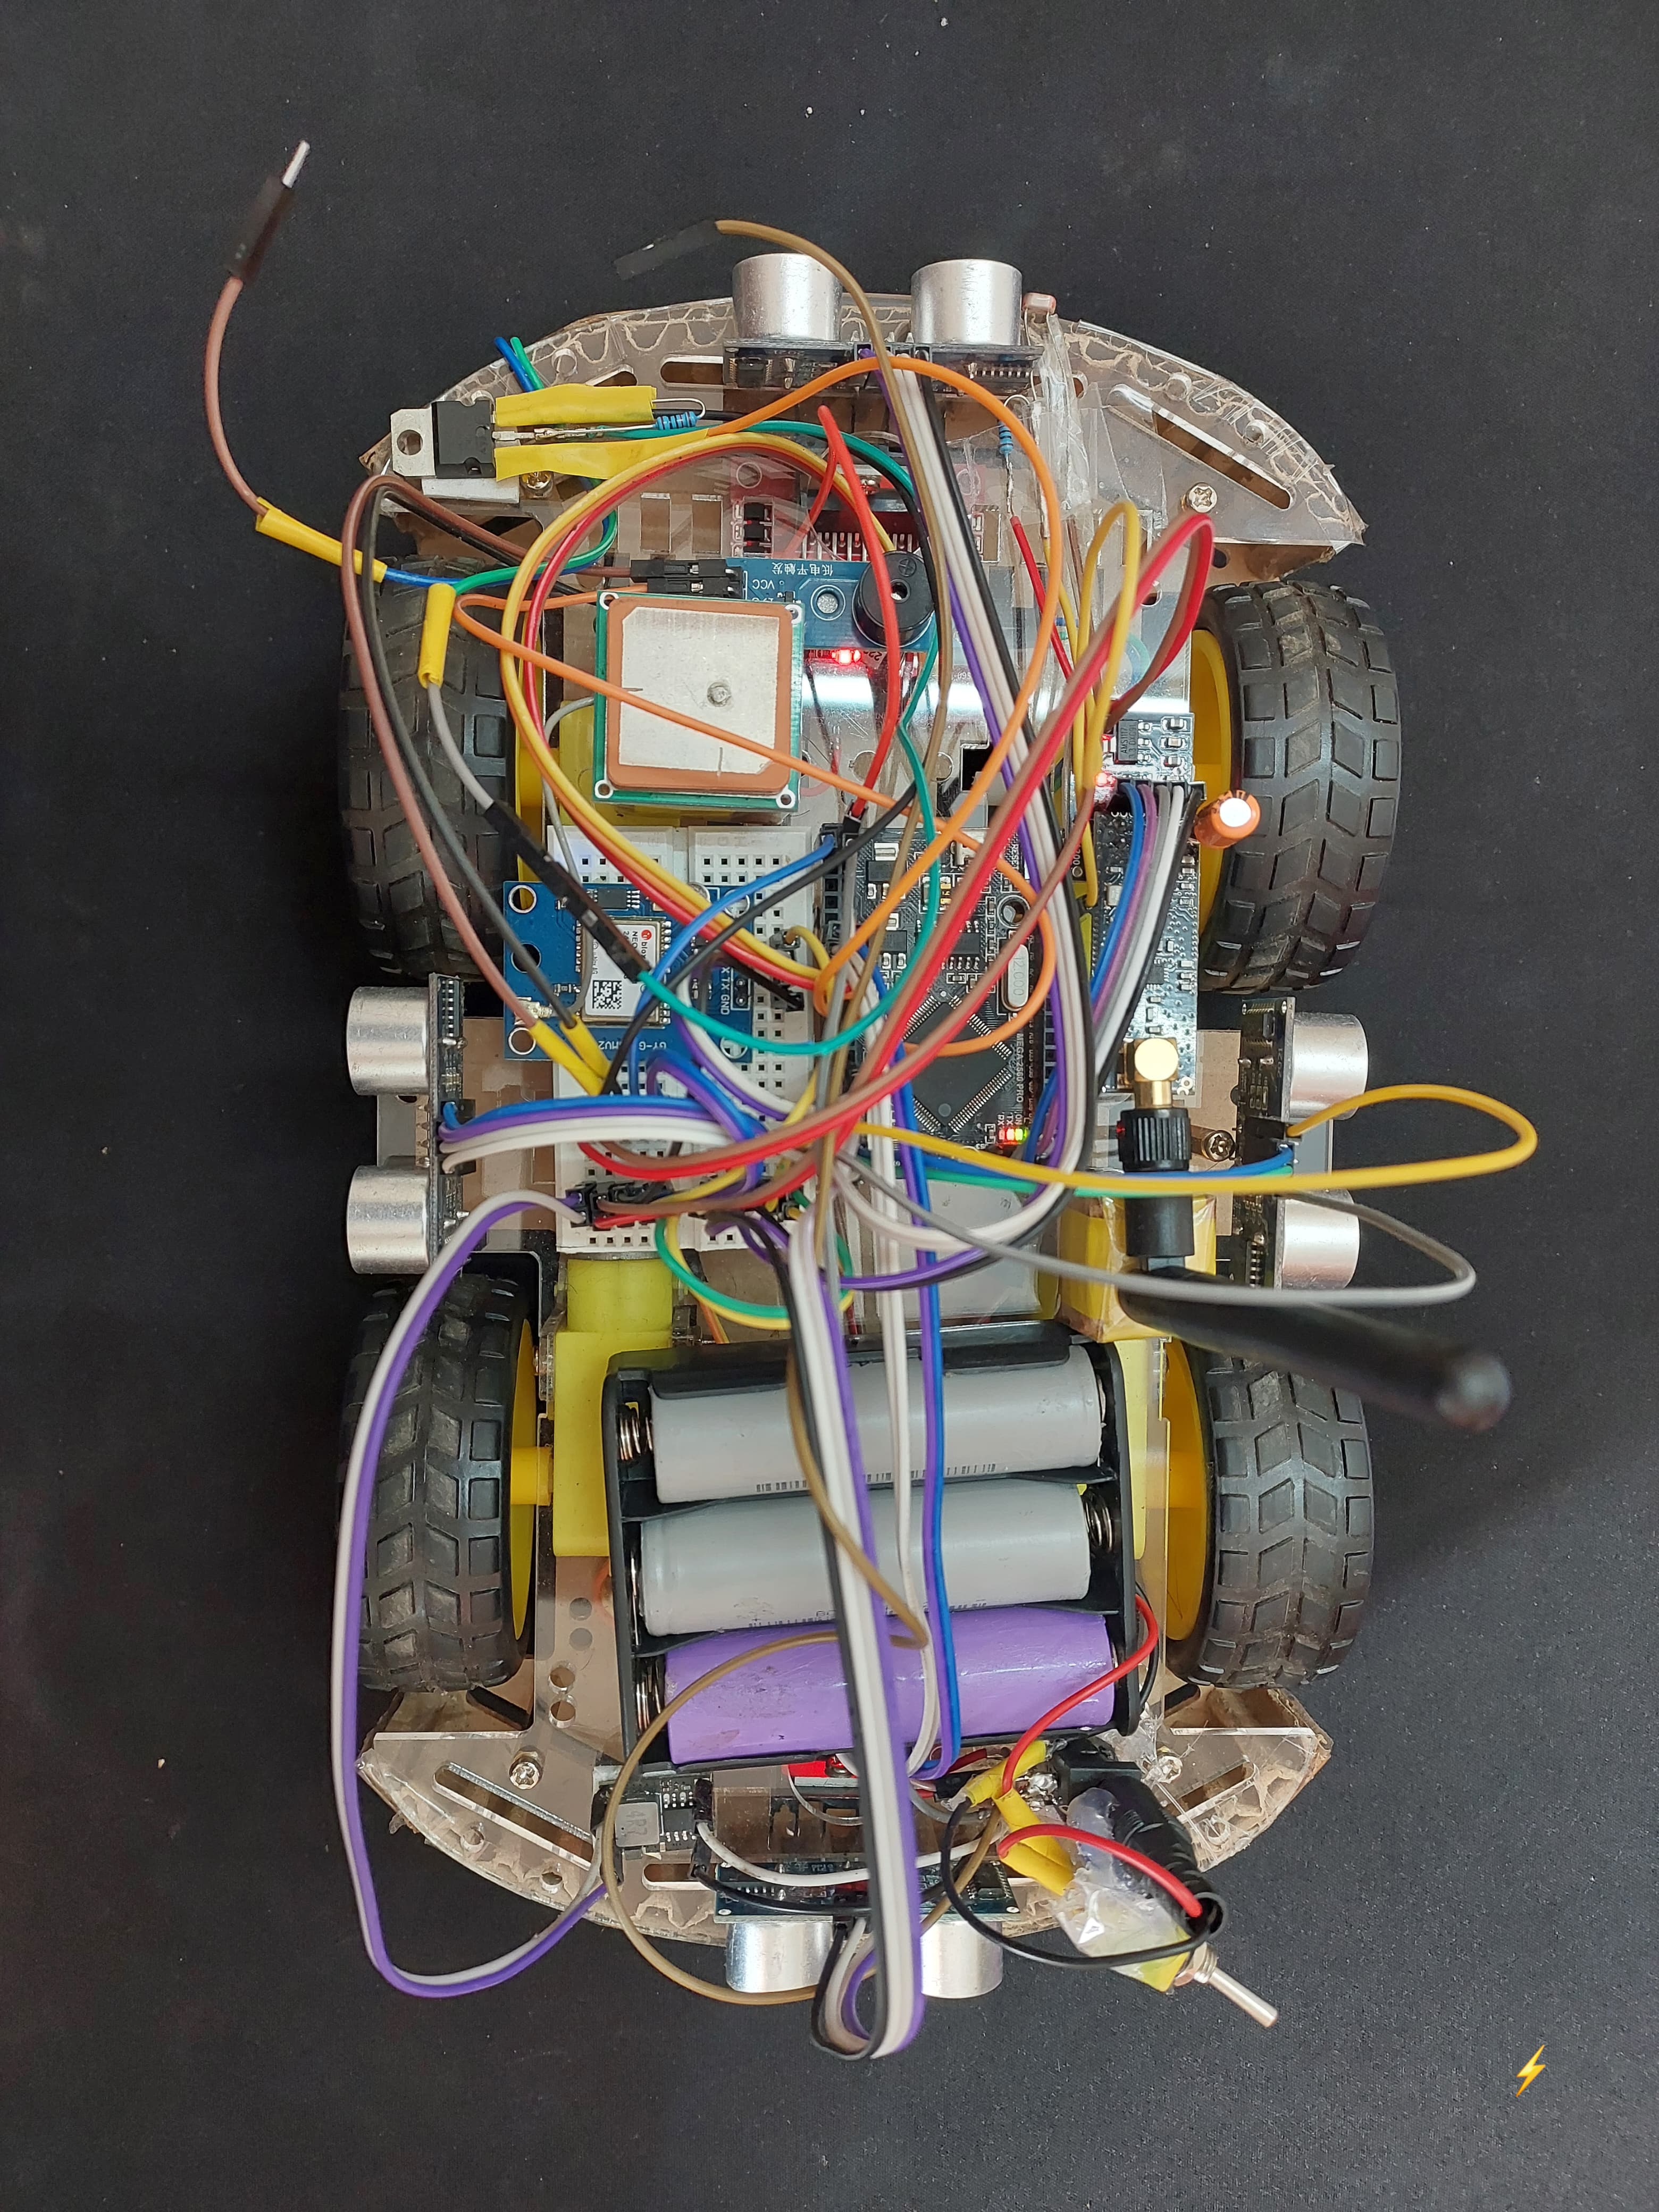
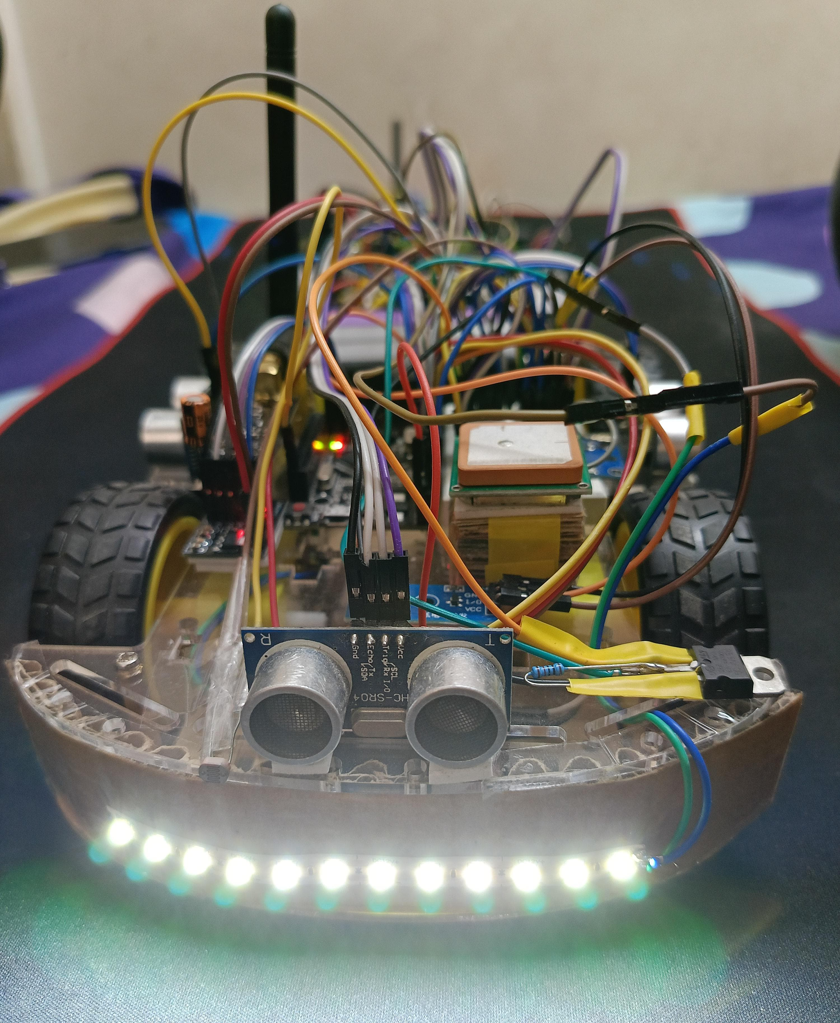
HINT: To change this single image.
1- Right Click on top of the image.
2- Choose “Change Picture” 3- Choose option “From a File” 4- Locate your file and open

Slide 15
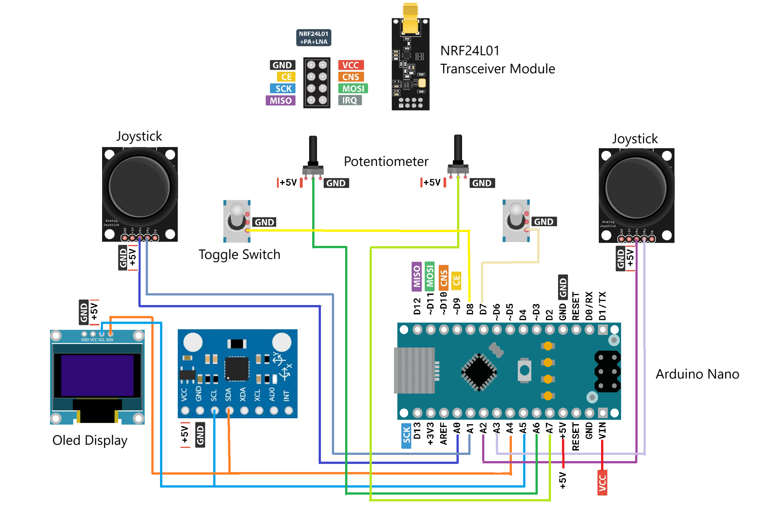
HINT: To change this single image.
1- Right Click on top of the image.
2- Choose “Change Picture” 3- Choose option “From a File” 4- Locate your file and open
CIRCUIT DIAGRAM FOR REMOTE

Slide 16
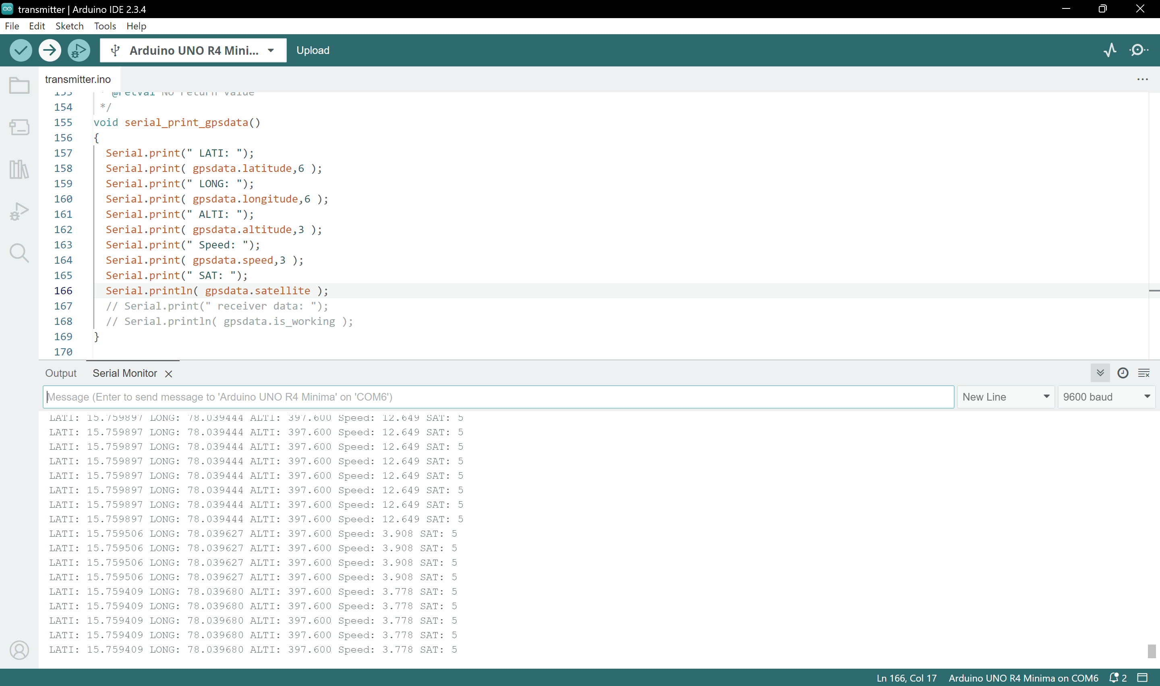
REMOTE SIDE RECEIVED DATA

Slide 17
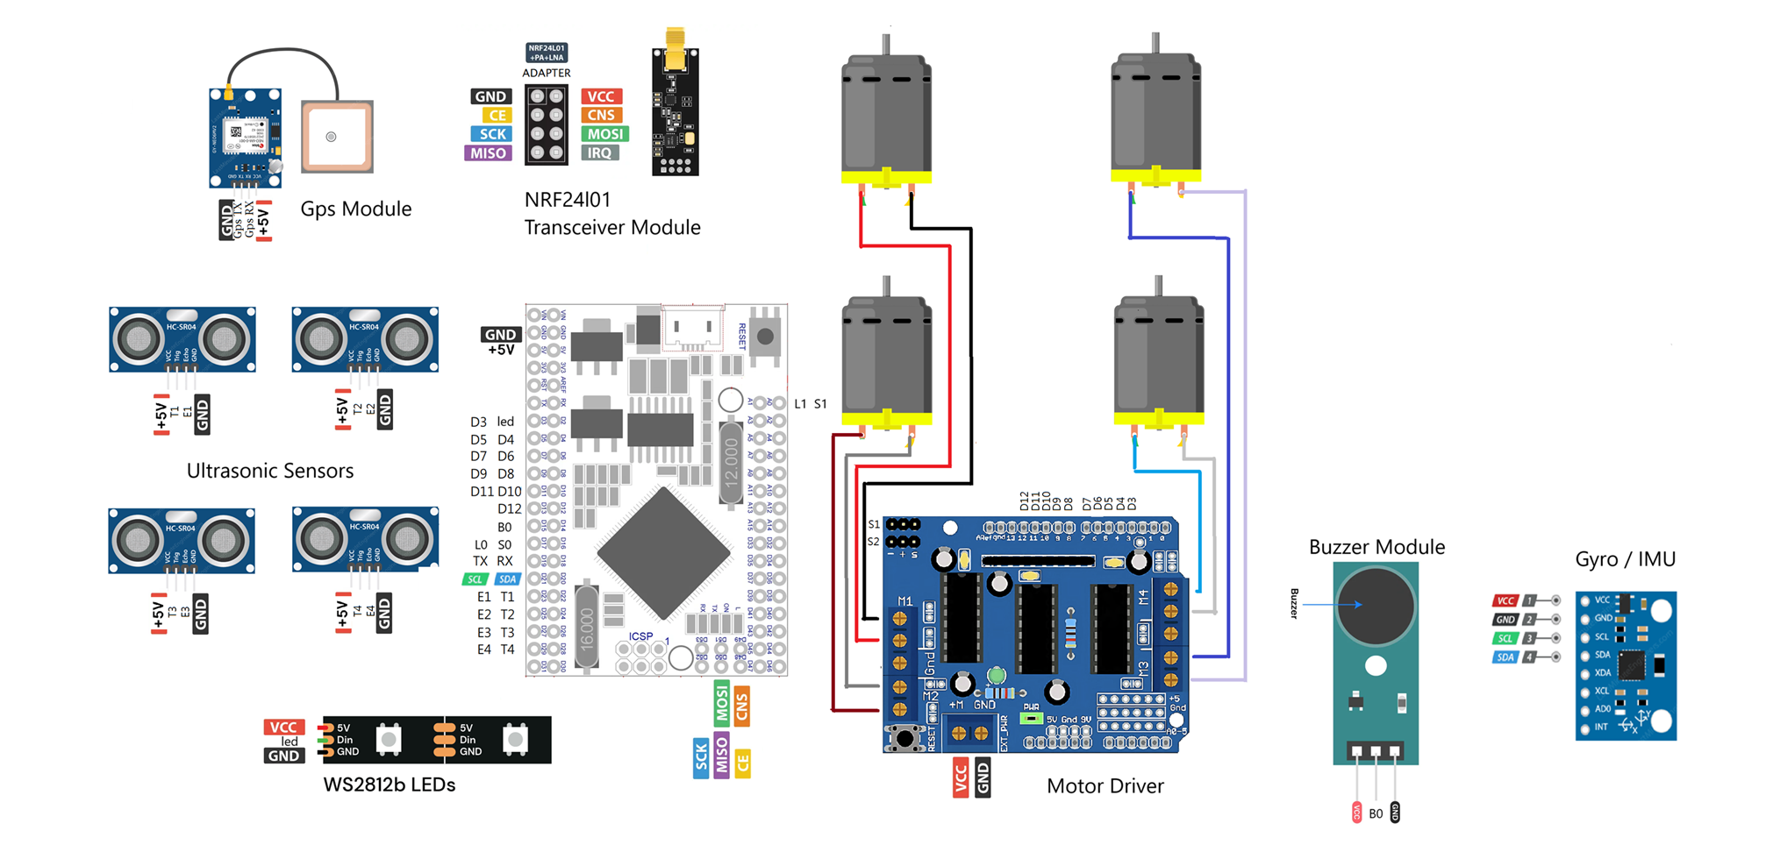
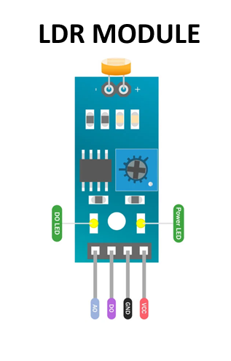
HINT: To change this single image.
1- Right Click on top of the image.
2- Choose “Change Picture” 3- Choose option “From a File” 4- Locate your file and open
CIRCUIT DIAGRAM FOR VEHICLE

Slide 18
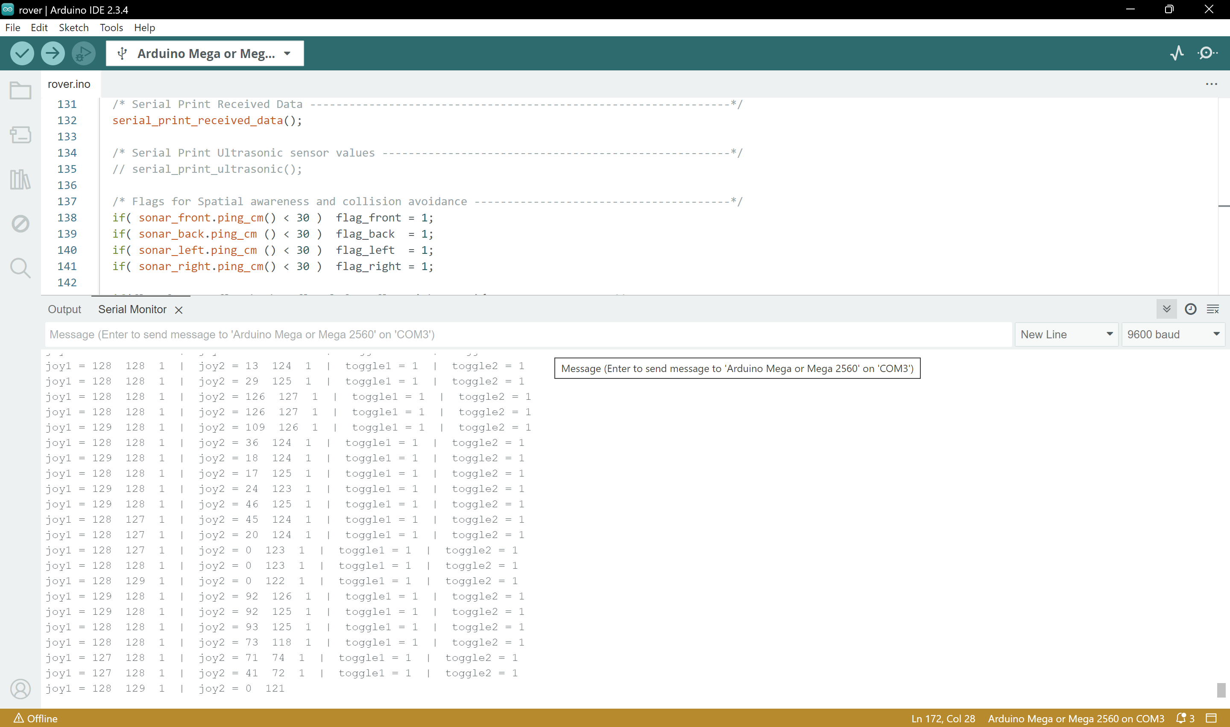
ROVER SIDE RECEIVED DATA

Slide 19
CODE FOR HORN REDUCTION :
HINT: To change this single image.
1- Right Click on top of the image.
2- Choose “Change Picture” 3- Choose option “From a File” 4- Locate your file and open
CODE :
#include <NewPing.h> // FOR ULTRASONIC SENSORS
#include <NewTone.h> // FOR BUZZER
#define maxdist 400 // FOR ULTRASONIC SENSORS
NewPing sonar_back (22 , 23 , maxdist); // Ultrasonic sensor trig, echo, maxdist
NewPing sonar_front(24 , 25 , maxdist);
NewPing sonar_right(26 , 27 , maxdist);
NewPing sonar_left (28 , 29 , maxdist);
int flag_front=0 , flag_back=0 , flag_left=0 , flag_right=0;
const int buzzerPin = 10; const int freq1 = 2000; const int freq2 = 4000;
if( sonar_front.ping_cm() < 30 ) flag_front = 1;
if( sonar_back.ping_cm () < 30 ) flag_back = 1;
if( sonar_left.ping_cm () < 30 ) flag_left = 1;
if( sonar_right.ping_cm() < 30 ) flag_right = 1;
if(flag_front + flag_back + flag_left + flag_right >= 3){ // HORN CODE
if(!data.joystick_2button)
NewTone(buzzerPin, freq1, 100); }
else{
if(!data.joystick_2button)
NewTone(buzzerPin, freq2, 100); }

Slide 20
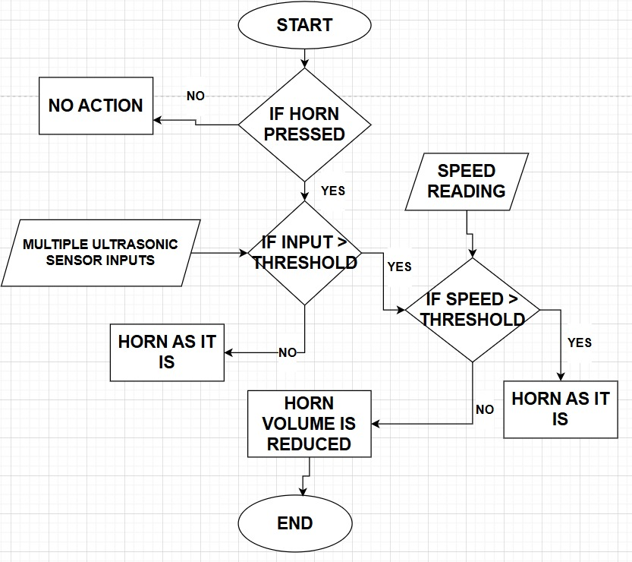
HINT: To change this single image.
1- Right Click on top of the image.
2- Choose “Change Picture” 3- Choose option “From a File” 4- Locate your file and open
FLOWCHART FOR HORN REDUCTION

Slide 21
CODE FOR LIGHT SENSITIVITY REDUCTION :
HINT: To change this single image.
1- Right Click on top of the image.
2- Choose “Change Picture” 3- Choose option “From a File” 4- Locate your file and open
CODE :
int ldr_value = analogRead(ldr_pin);
// Serial.println(ldr_value);
if (ldr_value <= ldr_intensity) {
digitalWrite(led_pin, LOW); }
else {
digitalWrite(led_pin, HIGH); }

Slide 22
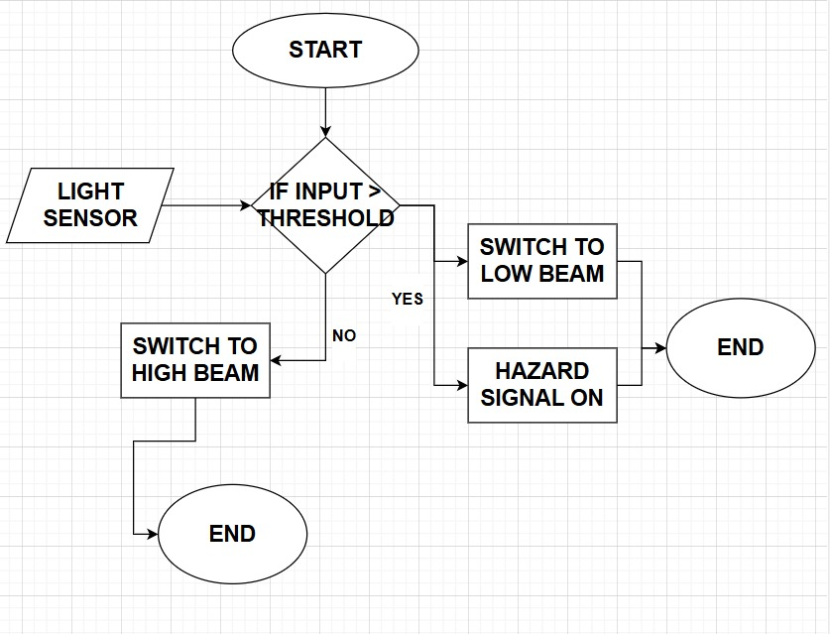
HINT: To change this single image.
1- Right Click on top of the image.
2- Choose “Change Picture” 3- Choose option “From a File” 4- Locate your file and open
FLOWCHART FOR LIGHT REDUCTION

Slide 23
WORKING OF HORN REDUCTION :
HINT: To change this single image.
1- Right Click on top of the image.
2- Choose “Change Picture” 3- Choose option “From a File” 4- Locate your file and open
At first we measure the distance of objects from the rover by considering the inputs received from Ultrasonic Sensors.
If distance is more than 30 cm , then there wont be any action on the buzzer (horn).
If distance is less than 30 cm ( in at least 3 directions ), then we are setting the flag = 1 for each direction.
If flag is equal to or more than 3 i.e. distance is less than 30 cm ( in 3 directions ), then the rover will stop there and wont move until that obstacle is cleared.
If distance is less than 30 cm ( in at least 3 directions ), then the horn intensity will be reduced to 100hz.
WORKING OF LIGHT SENSITIVITY REDUCTION :
We measure the intensity of light from the coming vehicle through the inputs of LDR sensor installed in rover.
If it is less than some certain limit, then the light intensity of our rover will be same .
If it is more than certain limit, then we are reducing our light intensity to lower beam.

Slide 24
CODE FOR GPS:
HINT: To change this single image.
1- Right Click on top of the image.
2- Choose “Change Picture” 3- Choose option “From a File” 4- Locate your file and open
CODE :
#include <TinyGPS++.h> // FOR GPS
while (neogps.available() > 0) // GET GPS DATA
if (gps.encode(neogps.read())) {
if ( gps.location.isValid() == 1 ) {
gpsdata.latitude = gps.location.lat();
gpsdata.longitude = gps.location.lng();
gpsdata.altitude = gps.altitude.meters();
gpsdata.speed = gps.speed.kmph();
gpsdata.satellite = gps.satellites.value(); }
// else
// { gpsdata.is_working = 1; } }
radio.write( &gpsdata, sizeof(gps_package) );
CODE :
void serial_print_gpsdata() {
Serial.print(" LATI: ");
Serial.print( gpsdata.latitude );
Serial.print(" LONG: ");
Serial.print( gpsdata.longitude );
Serial.print(" ALTI: ");
Serial.print( gpsdata.altitude );
Serial.print(" Speed: ");
Serial.print( gpsdata.speed );
Serial.print(" SAT: ");
Serial.print( gpsdata.satellite );
Serial.print(" receiver data: ");
Serial.println( gpsdata.is_working ); }

Slide 25
CODE FOR MOVEMENT OF ROVER:
HINT: To change this single image.
1- Right Click on top of the image.
2- Choose “Change Picture” 3- Choose option “From a File” 4- Locate your file and open
CODE :
// if ((data.joystick_1Y > 150)&&flag_front==0 ) // FOR COLLISON AVOIDANCE
if (data.joystick_1Y > 150 )
{ // FORWARD
digitalWrite(motor1_forward, HIGH); digitalWrite(motor1_backward, LOW);
digitalWrite(motor2_forward, HIGH); digitalWrite(motor2_backward, LOW);
digitalWrite(motor3_forward, HIGH); digitalWrite(motor3_backward, LOW);
digitalWrite(motor4_forward, HIGH); digitalWrite(motor4_backward, LOW);
}
// else if ((data.joystick_1Y < 104)&&flag_back==0 ) // FOR COLLISON AVOIDANCE
else if (data.joystick_1Y < 104 )
{ // BACKWARD
digitalWrite(motor1_forward, LOW); digitalWrite(motor1_backward, HIGH);
digitalWrite(motor2_forward, LOW); digitalWrite(motor2_backward, HIGH);
digitalWrite(motor3_forward, LOW); digitalWrite(motor3_backward, HIGH);
digitalWrite(motor4_forward, LOW); digitalWrite(motor4_backward, HIGH);
}
else if (data.joystick_2X < 104 )
{ // ANTI CLOCKWISE
digitalWrite(motor1_forward, LOW); digitalWrite(motor1_backward, HIGH);
digitalWrite(motor2_forward, HIGH); digitalWrite(motor2_backward, LOW);
digitalWrite(motor3_forward, HIGH); digitalWrite(motor3_backward, LOW);
digitalWrite(motor4_forward, LOW); digitalWrite(motor4_backward, HIGH);
}

Slide 26
CODE FOR MOVEMENT OF ROVER :
HINT: To change this single image.
1- Right Click on top of the image.
2- Choose “Change Picture” 3- Choose option “From a File” 4- Locate your file and open
CODE :
else if (data.joystick_2X > 150 )
{ // CLOCKWISE
digitalWrite(motor1_forward, HIGH); digitalWrite(motor1_backward, LOW);
digitalWrite(motor2_forward, LOW); digitalWrite(motor2_backward, HIGH);
digitalWrite(motor3_forward, LOW); digitalWrite(motor3_backward, HIGH);
digitalWrite(motor4_forward, HIGH); digitalWrite(motor4_backward, LOW);
}
else // STOP MOVING
stop_motors();
void stop_motors(){
digitalWrite(motor1_forward, LOW); digitalWrite(motor1_backward, LOW);
digitalWrite(motor2_forward, LOW); digitalWrite(motor2_backward, LOW);
digitalWrite(motor3_forward, LOW); digitalWrite(motor3_backward, LOW);
digitalWrite(motor4_forward, LOW); digitalWrite(motor4_backward, LOW);
}
flag_front=0 ; flag_back=0 ; flag_left=0 ; flag_right=0; // FOR COLLISON AVOIDANCE
delay(5);

Slide 27
HINT: To change this single image.
1- Right Click on top of the image.
2- Choose “Change Picture” 3- Choose option “From a File” 4- Locate your file and open
ARDUINO UNO R4 :
POWER :
Operating Voltage: 5V DC, VIN: 7V–12V
USB Supply: 5V (Type-B USB)
Max Current per I/O Pin: 40mA
FEATURES :
Microcontroller: ATmega328P, 16MHz
Memory: 32KB Flash, 2KB SRAM, 1KB EEPROM
20 Pins: 14 Digital (6 PWM), 6 Analog
Communication: UART, SPI, I2C
Larger, prototyping-friendly, used in automation, motor control, and education
DIMENSIONS :
68.6mm × 53.4mm × 10mm

Slide 28
HINT: To change this single image.
1- Right Click on top of the image.
2- Choose “Change Picture” 3- Choose option “From a File” 4- Locate your file and open
TRANSCEIVER ANTENNA:
POWER :
Varies based on the wireless module (typically 3.3V – 5V).
FEATURES :
Enhances signal strength and range for Wi-Fi, Bluetooth, LoRa, NRF24L01, and RF modules.
Frequency Range: Common bands include 433MHz, 868MHz, 915MHz, and 2.4GHz.
Types of Antennas:
Whip Antenna (Flexible, cylindrical shape)
PCB Antenna (Printed on PCB for compact devices)
Helical Antenna (Spring-like design for enhanced performance)
Used in wireless communication, IoT devices, and remote monitoring systems.
DIMENSIONS :
Length: Varies (5cm – 15cm depending on type and frequency)

Slide 29
HINT: To change this single image.
1- Right Click on top of the image.
2- Choose “Change Picture” 3- Choose option “From a File” 4- Locate your file and open
ULTRASONIC SENSOR:
POWER :
Operating Voltage: 5V DC
Current Consumption: 15mA
Operating Frequency: 40 kHz
FEATURES :
Measurement Range: 2cm – 400cm
Accuracy: ±3mm
Interface: Trigger & Echo Pins
Angle of Detection: 15°
Working Principle: Emits ultrasonic waves, calculates distance based on time delay between transmission and echo reception
Commonly used in distance measurement, obstacle detection, robotics, and automation
DIMENSIONS :
Length: 45mm
Width: 20mm
Height: 15mm

Slide 30
HINT: To change this single image.
1- Right Click on top of the image.
2- Choose “Change Picture” 3- Choose option “From a File” 4- Locate your file and open
MOTOR DRIVER MODULE:
POWER :
Logic Voltage: 5V DC
Motor Voltage: 5V – 35V DC
Current: Up to 2A per channel
FEATURES :
Dual H-Bridge motor driver, capable of controlling two DC motors or one stepper motor.
Built-in 78M05 voltage regulator to provide a 5V logic supply if an external 5V source isn’t used.
Four control pins (IN1, IN2, IN3, IN4) for direction control.
PWM (Pulse Width Modulation) support for speed control.
Overheating and overcurrent protection with a built-in heat sink.
Used in robotics, automation, and motor control applications.
DIMENSIONS :
Length: 43mm
Width: 43mm
Height: 27mm

Slide 31
HINT: To change this single image.
1- Right Click on top of the image.
2- Choose “Change Picture” 3- Choose option “From a File” 4- Locate your file and open
GPS NEO-6M MODULE:
POWER :
Operating: 2.7V – 3.6V (typical: 3.3V).
Can tolerate 5V logic with level shifters.
Current Consumption: 45 mA (typical).
Supports 3V backup battery for faster cold starts.
FEATURES :
Two GNSS Support: GPS (Global Positioning System).
Position Accuracy: 2.5 m (standard accuracy).
Sensitivity:-161 dBm tracking sensitivity.
Baud Rate: Default: 9600 bps (adjustable).
Communication Interface: UART (TX/RX pins).
Update Rate: Up to 5 Hz.
Cold Start Time: ~38 sec.
Hot Start Time: ~1 sec (with backup battery).
Data Output: NMEA sentences (GGA, GLL, GSA, GSV, RMC, VTG).

Slide 32
HINT: To change this single image.
1- Right Click on top of the image.
2- Choose “Change Picture” 3- Choose option “From a File” 4- Locate your file and open
GPS NEO-6M MODULE:
POWER :
Operating Voltage: 3.3V – 5V DC
Power: 3.3V/5V, 20-40 mA, low power sleep mode.
FEATURES :
Commonly 128x64 pixels.
I2C (2-wire protocol: SDA, SCL).
Adjustable contrast through software.
Up to 160° visibility.
DIMENSIONS :
Display area: 29.42 x 14.7 mm
Module size: 35 x 28 mm
Thickness: ~1.5 mm
Pin pitch: 2.54 mm

Slide 33
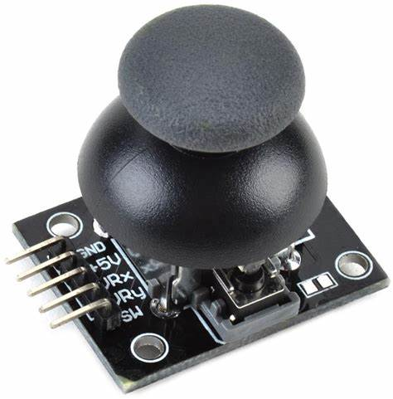
HINT: To change this single image.
1- Right Click on top of the image.
2- Choose “Change Picture” 3- Choose option “From a File” 4- Locate your file and open
JOYSTICK MODULE:
POWER :
Operating Voltage: 3.3V – 5V DC
Current Consumption: Low power (<10mA)
FEATURES :
Two potentiometers for measuring X and Y-axis movement.
Push-button function when joystick is pressed down.
Outputs analog signals (0V – VCC) corresponding to joystick position.
Can be connected to Arduino, Raspberry Pi, and microcontrollers.
Used in robotics, gaming controllers, and remote-controlled systems.
DIMENSIONS :
Length: 34mm
Width: 26mm
Height: 32mm

Slide 34


THANK YOU

